Slide 1
MENA CONCENTRATION & HEALTH OUTCOMES
(Michigan only)

Slide 2
SUMMARY STATISTICS OF MENA CONCENTRATION
(for tracts w/ health outcome info. only)

Slide 3
Summary Stats – All Tracts in MI
No. of tracts | 3,017
Mean | 0.02
Std. Dev. | 0.076
Median | 0
Min. | 0
Max. | 0.883
Percentile | MENA concentration
1 | 0
25 | 0
50 | 0
75 | 0
90 | 0.0517
95 | 0.0974
99 | 0.3945

Slide 4
Summary Stats – Tracts w/ Nonzero MENA Concentration
No. of tracts | 599
Mean | 0.102
Std. Dev. | 0.143
Median | 0.0518
Min. | 0.0134
Max. | 0.883
Percentile | MENA concentration
1 | 0.0151
25 | 0.0329
50 | 0.0518
75 | 0.0982
90 | 0.2384
95 | 0.4006
99 | 0.8318

Slide 5
IMPORTANT NOTES ABOUT CHARTS

Slide 6
For coefficients of all scatterplots:
Universe is all tracts with a nonzero MENA concentration
Standard errors in parentheses
***p < 0.01, **p < 0.05, *p < 0.1
For all bar charts:
95% confidence intervals shown
”Median” refers to median MENA concentration of tracts with nonzero MENA concentration
For Michigan, this is 0.0518
All health outcome data sourced from CDC PLACES datasets

Slide 7
PREVALENCE OF MEDICAL CONDITIONS

Slide 8
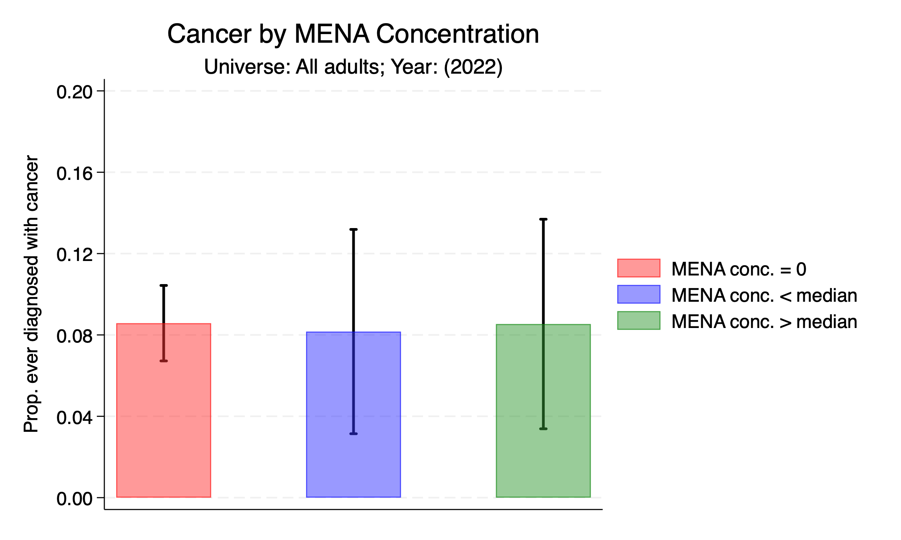

Slide 9
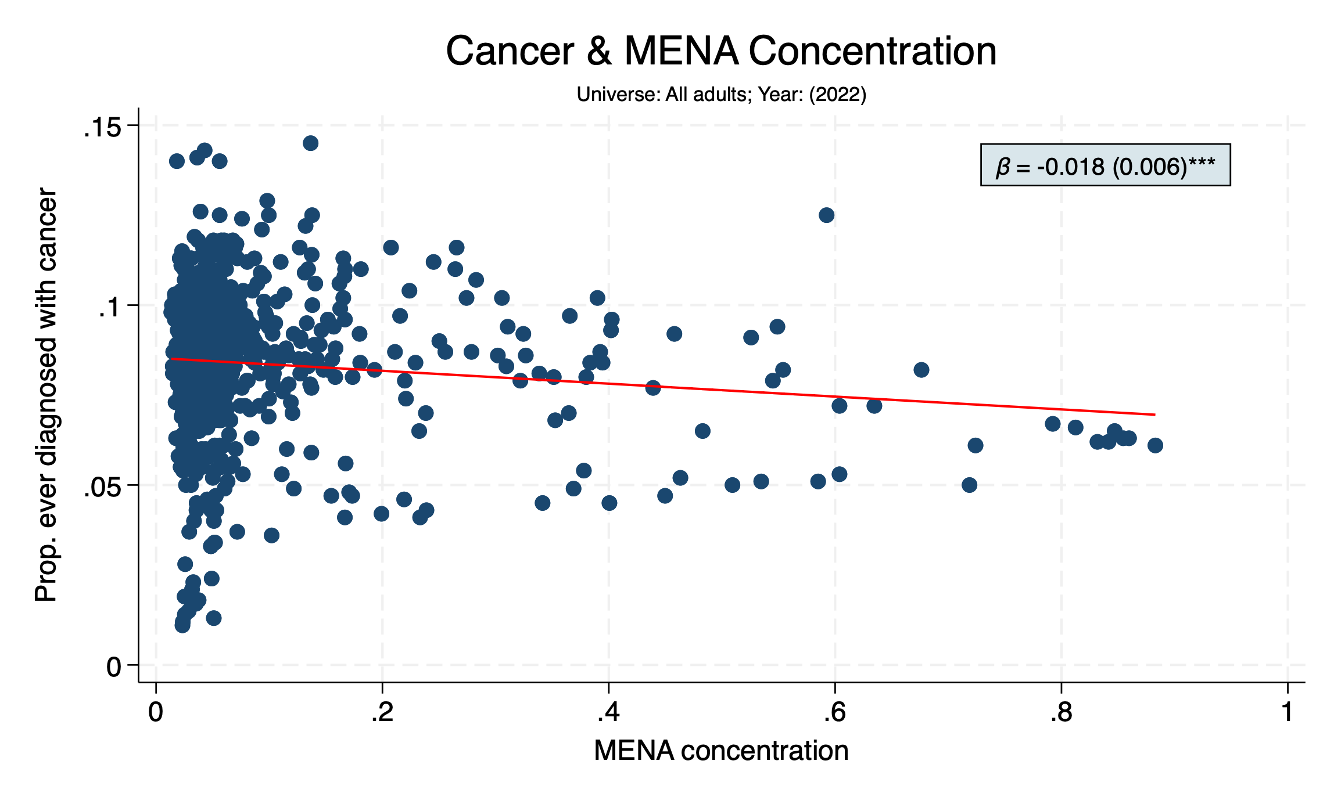

Slide 10
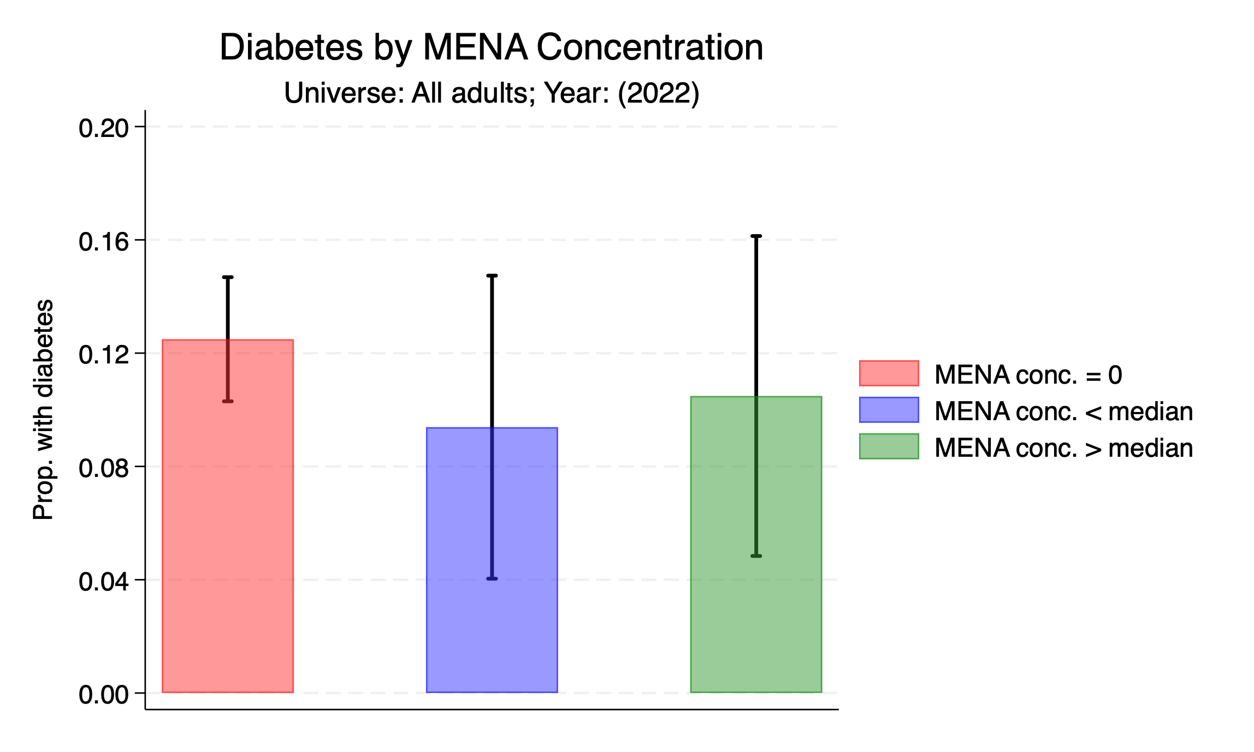

Slide 11
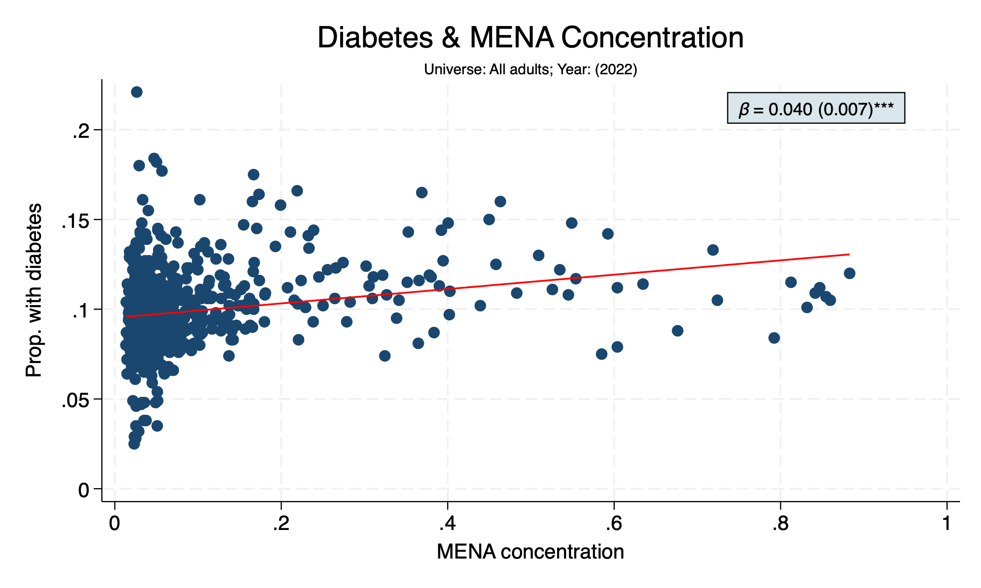

Slide 12
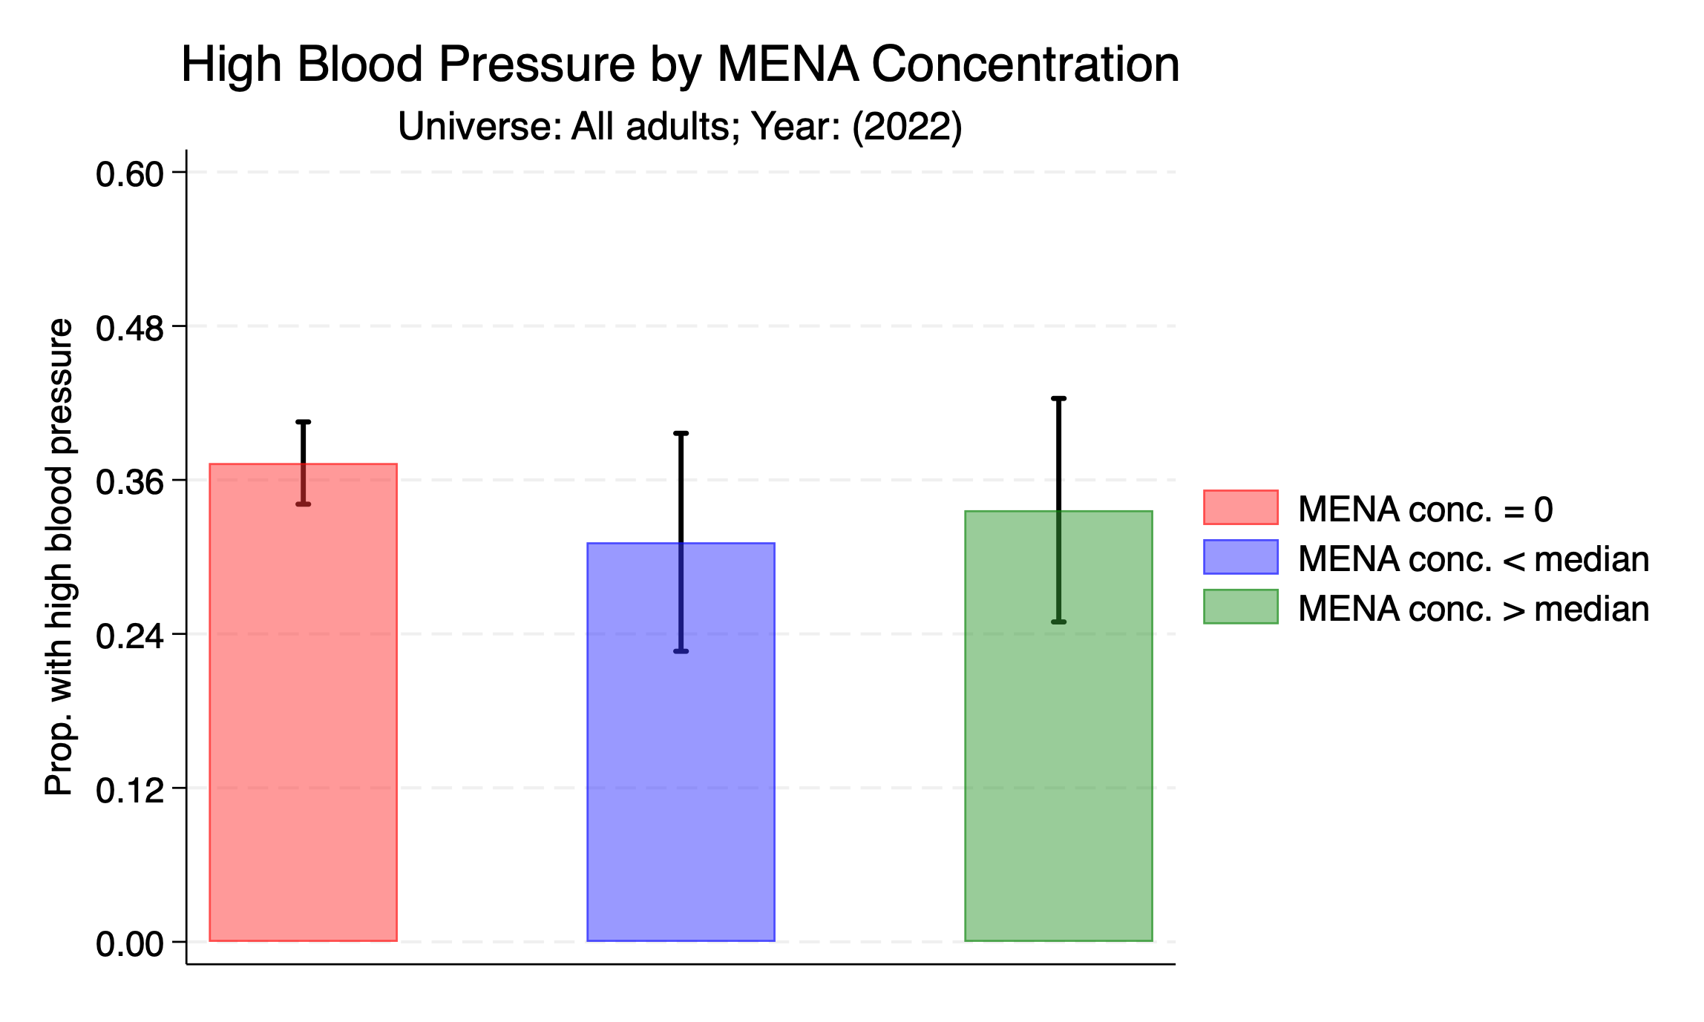

Slide 13
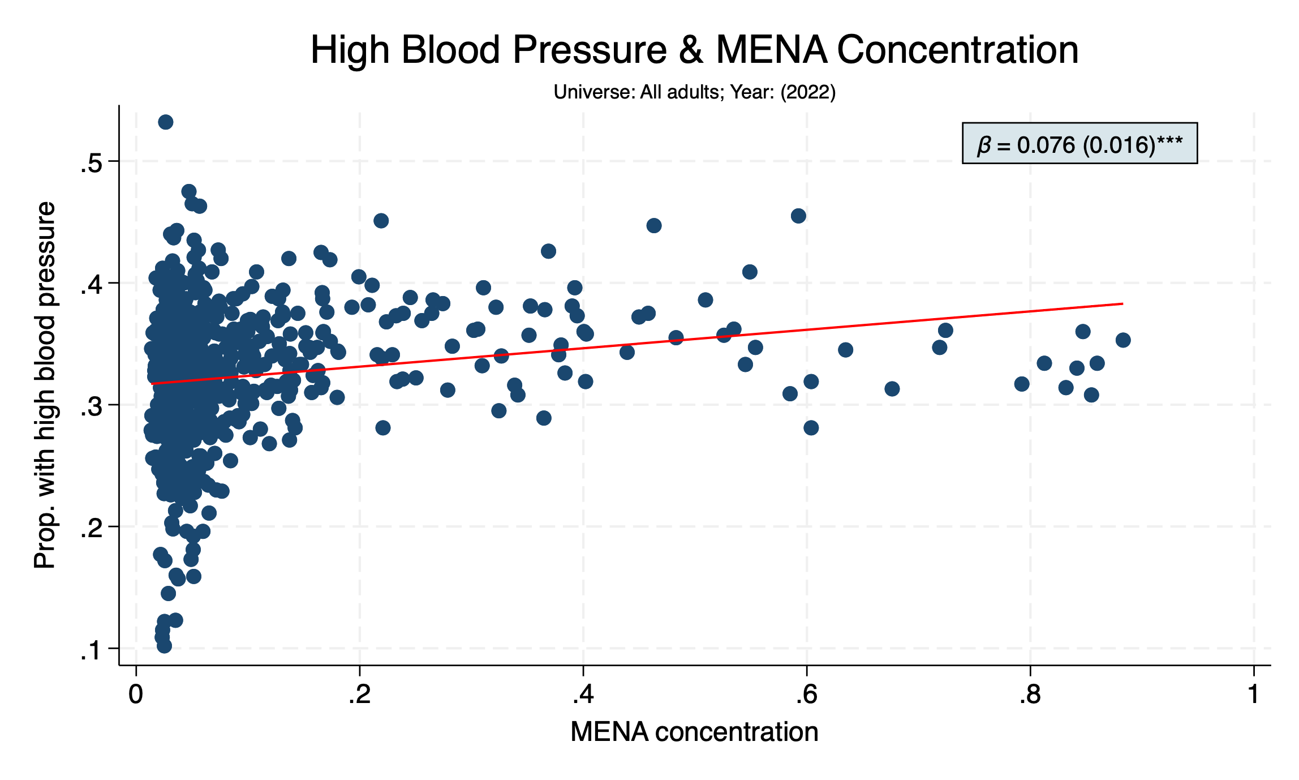

Slide 14
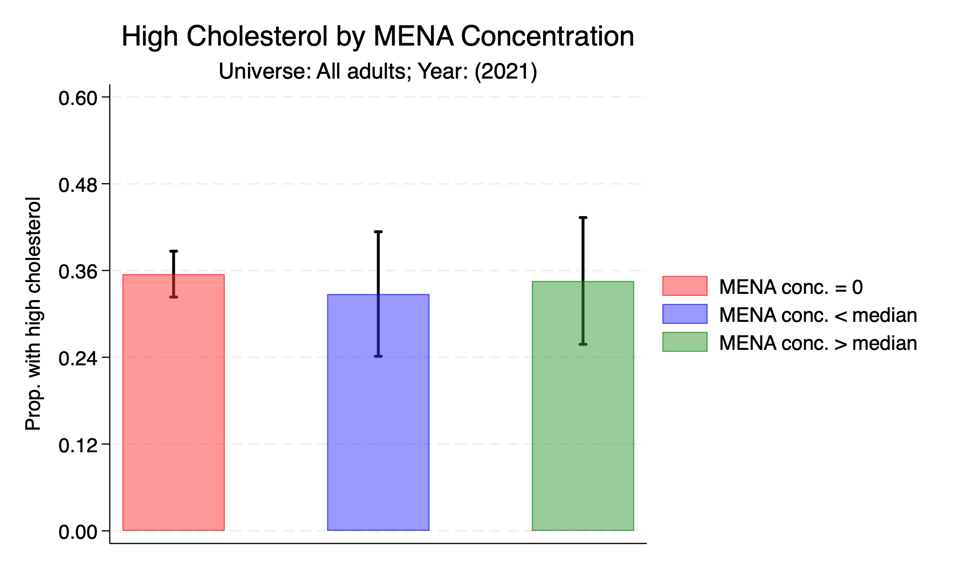

Slide 15
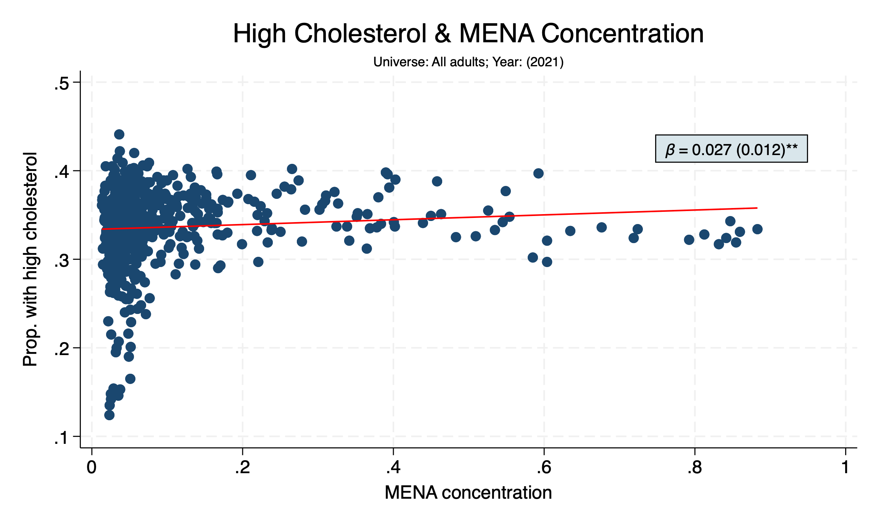

Slide 16
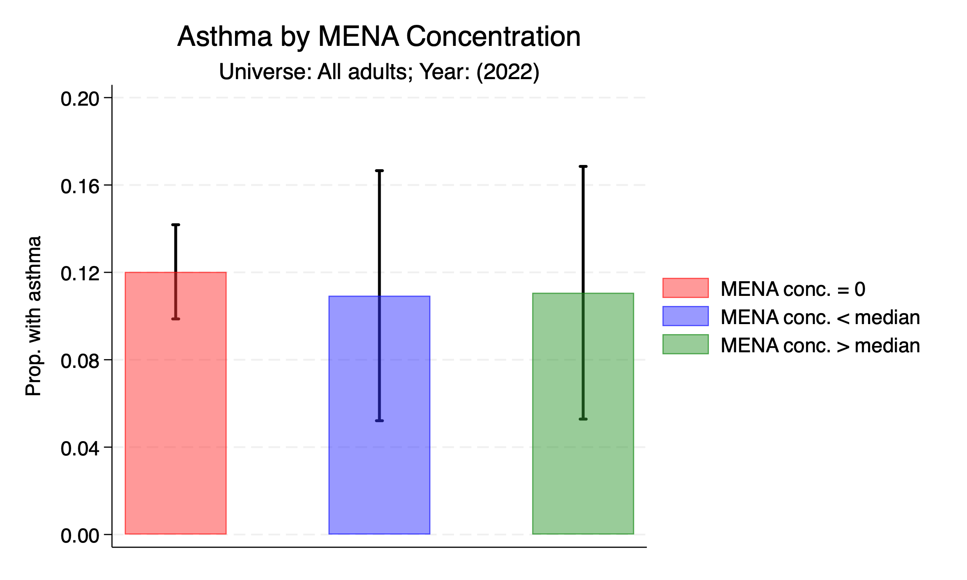

Slide 17
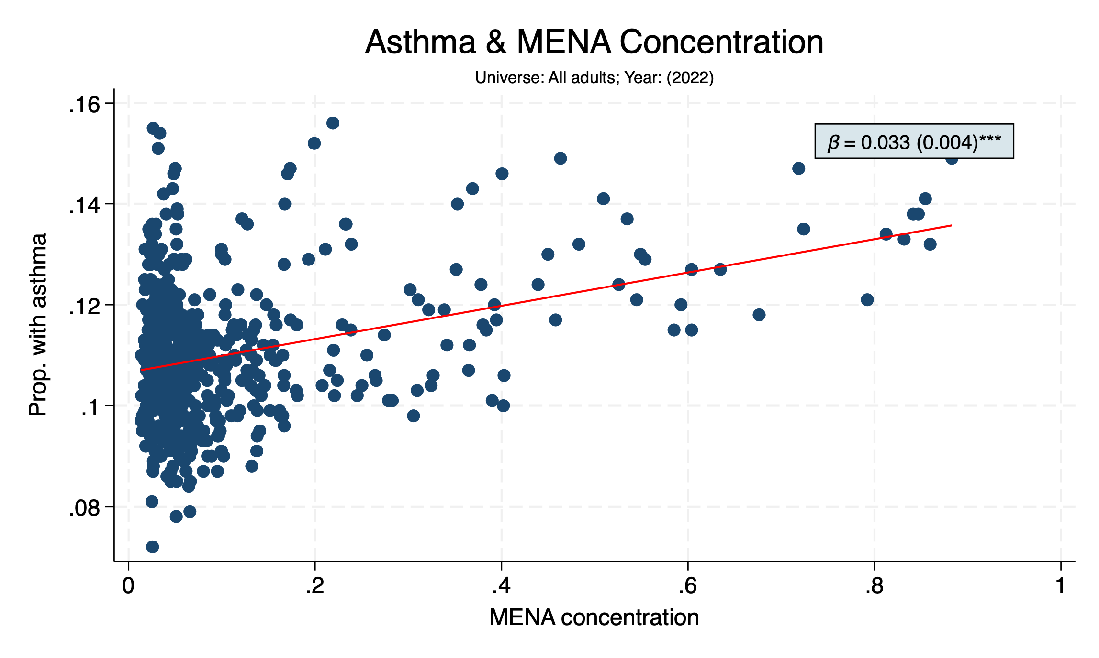

Slide 18
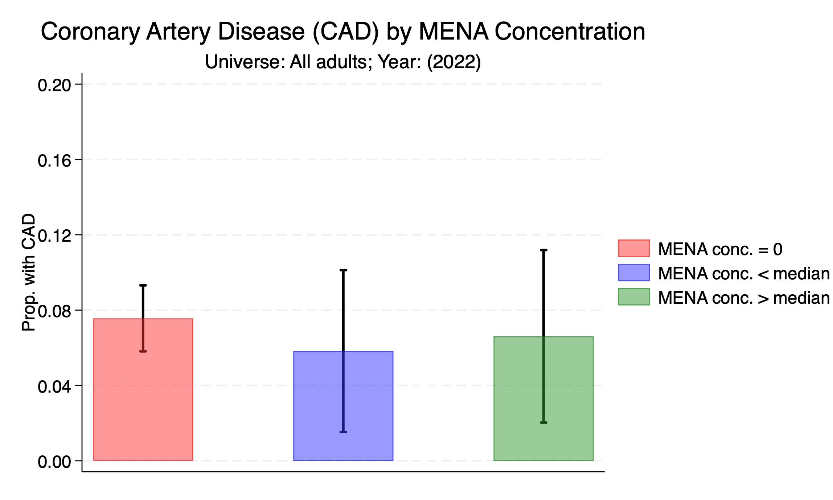

Slide 19
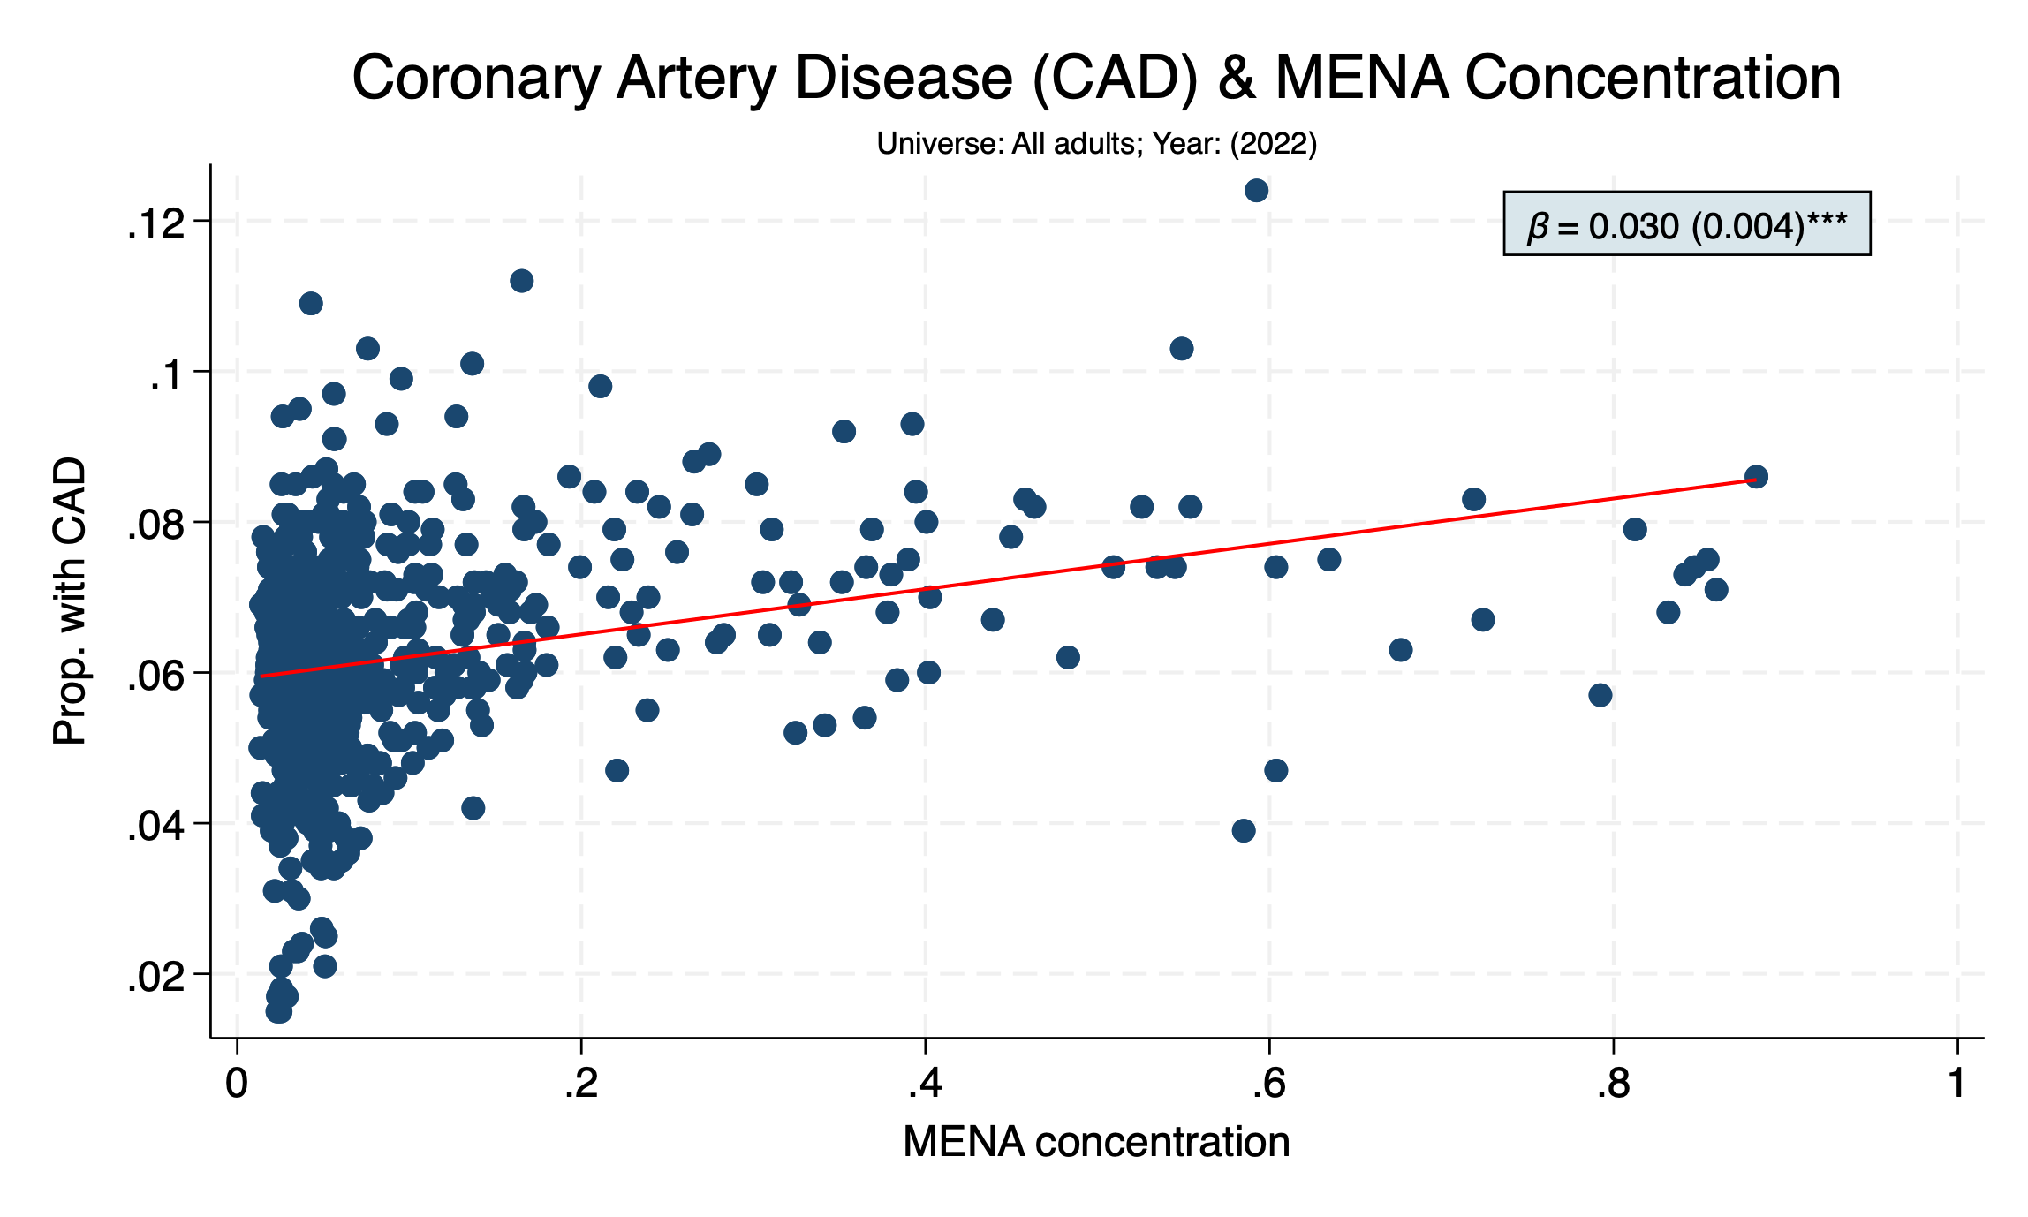

Slide 20
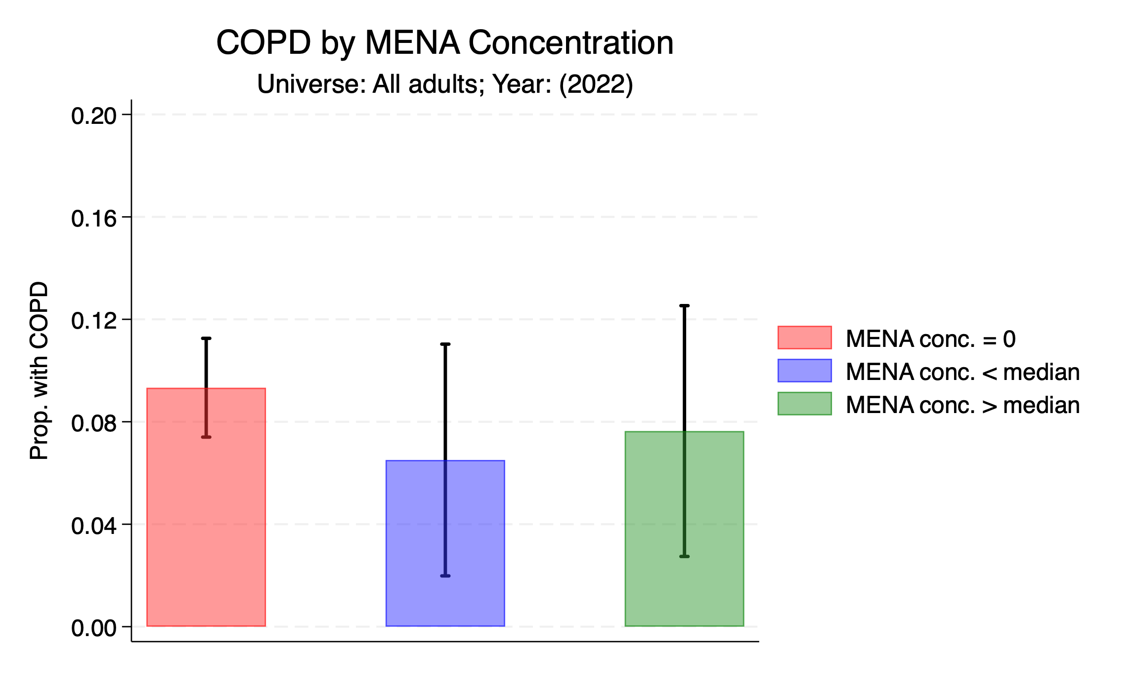

Slide 21
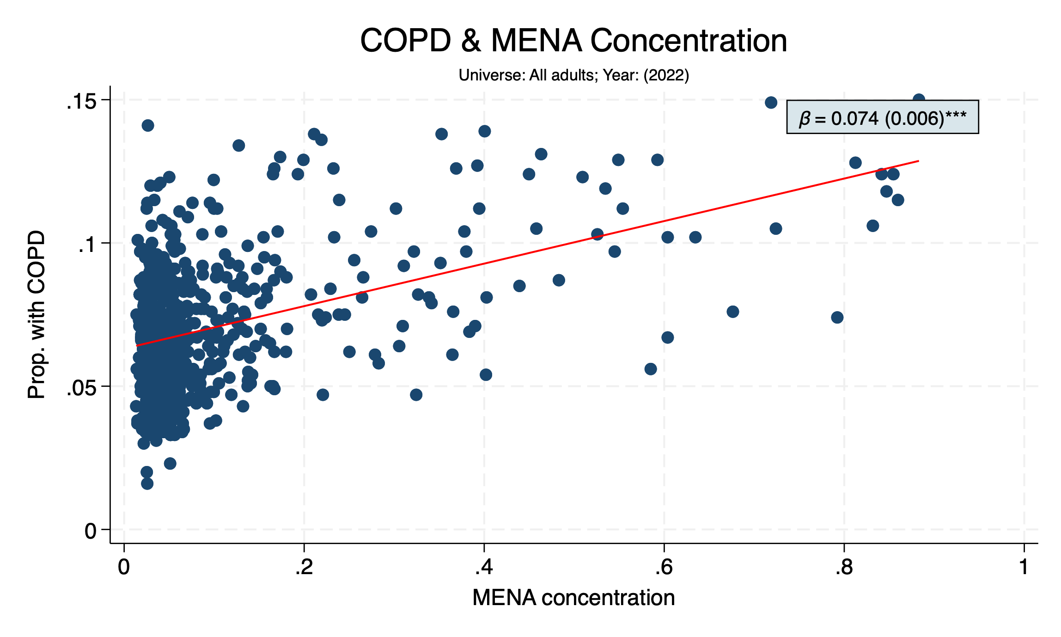

Slide 22
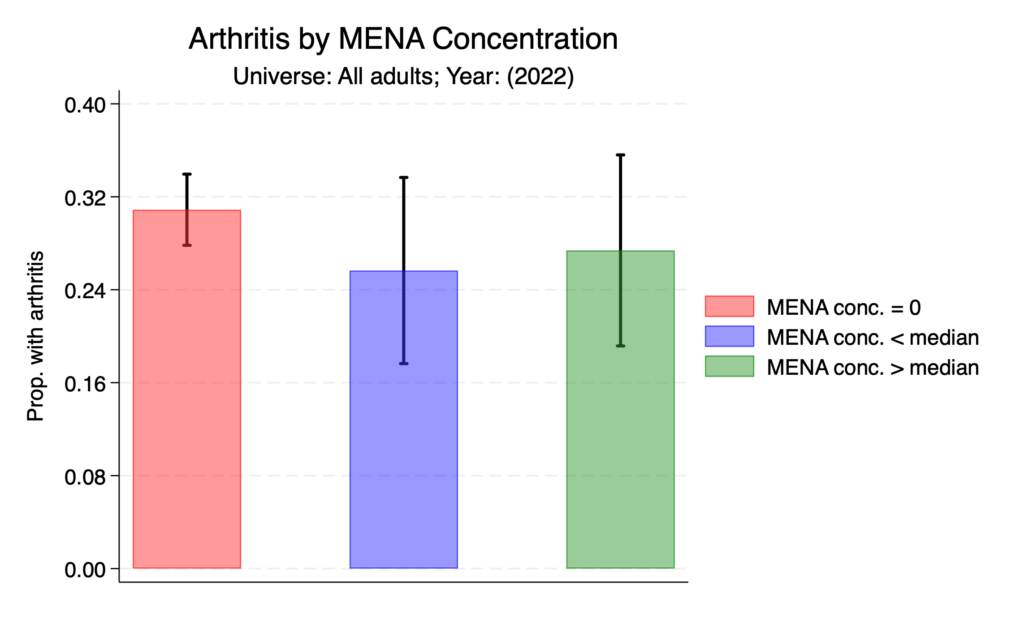

Slide 23
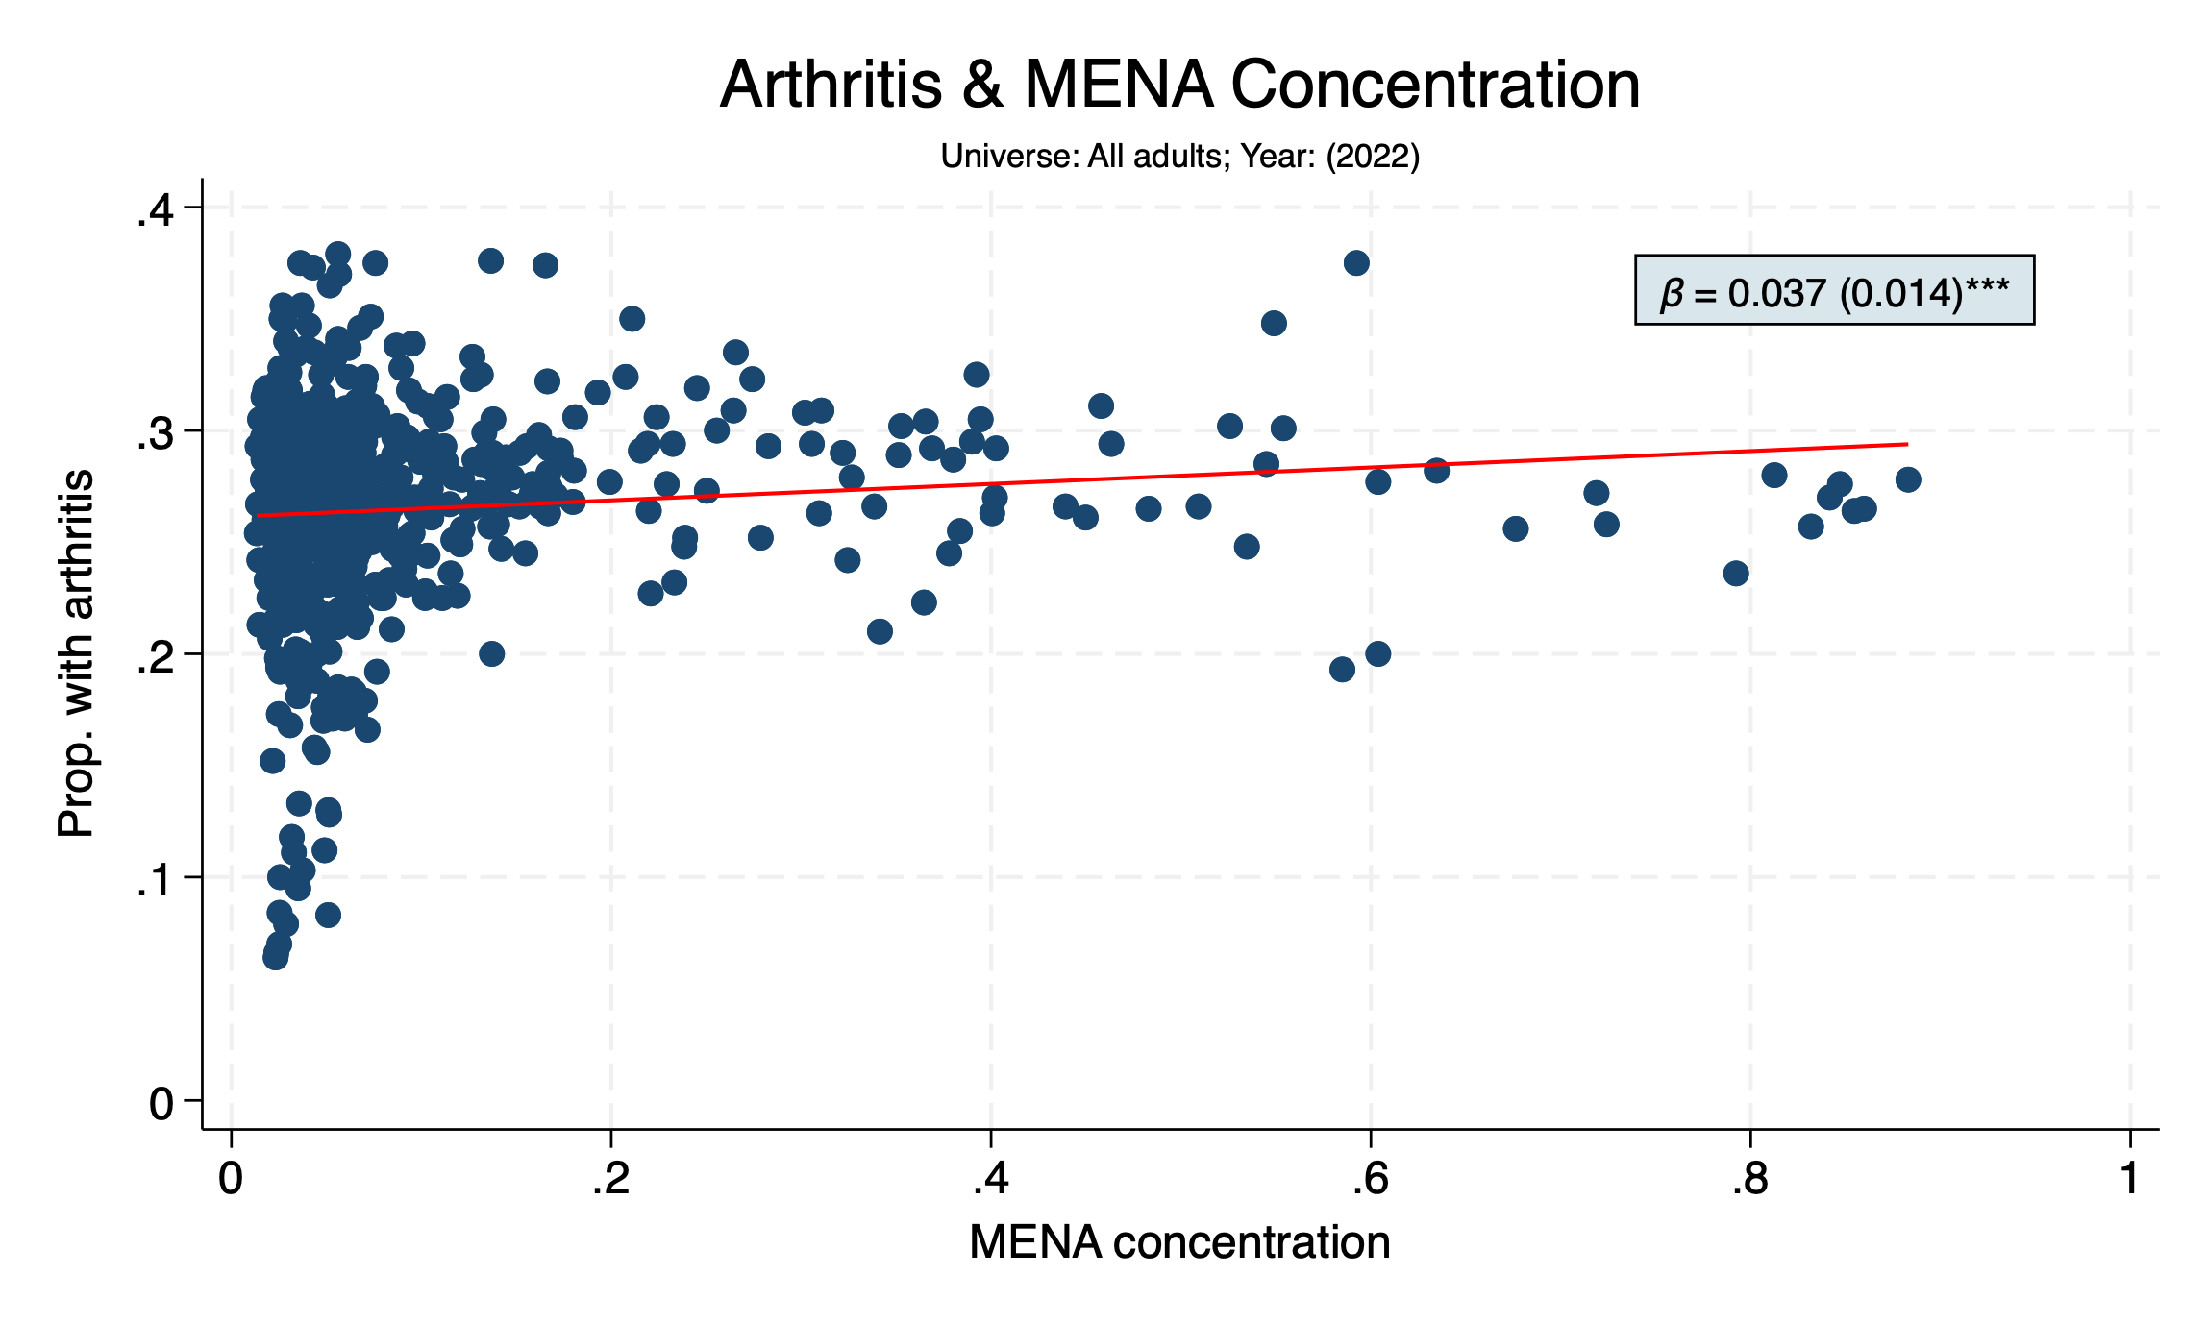

Slide 24


Slide 25
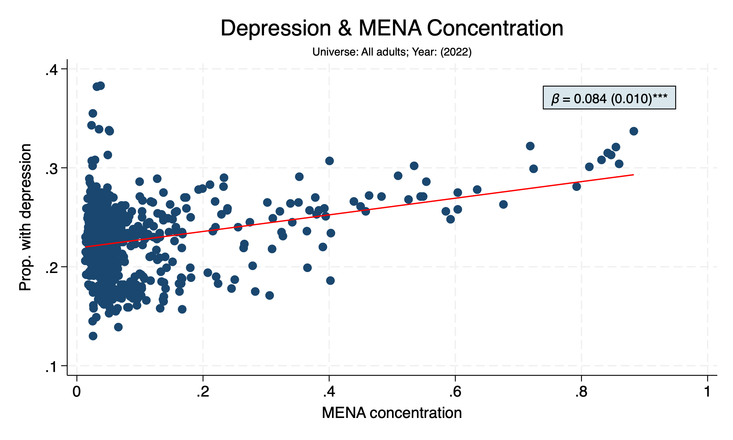

Slide 26
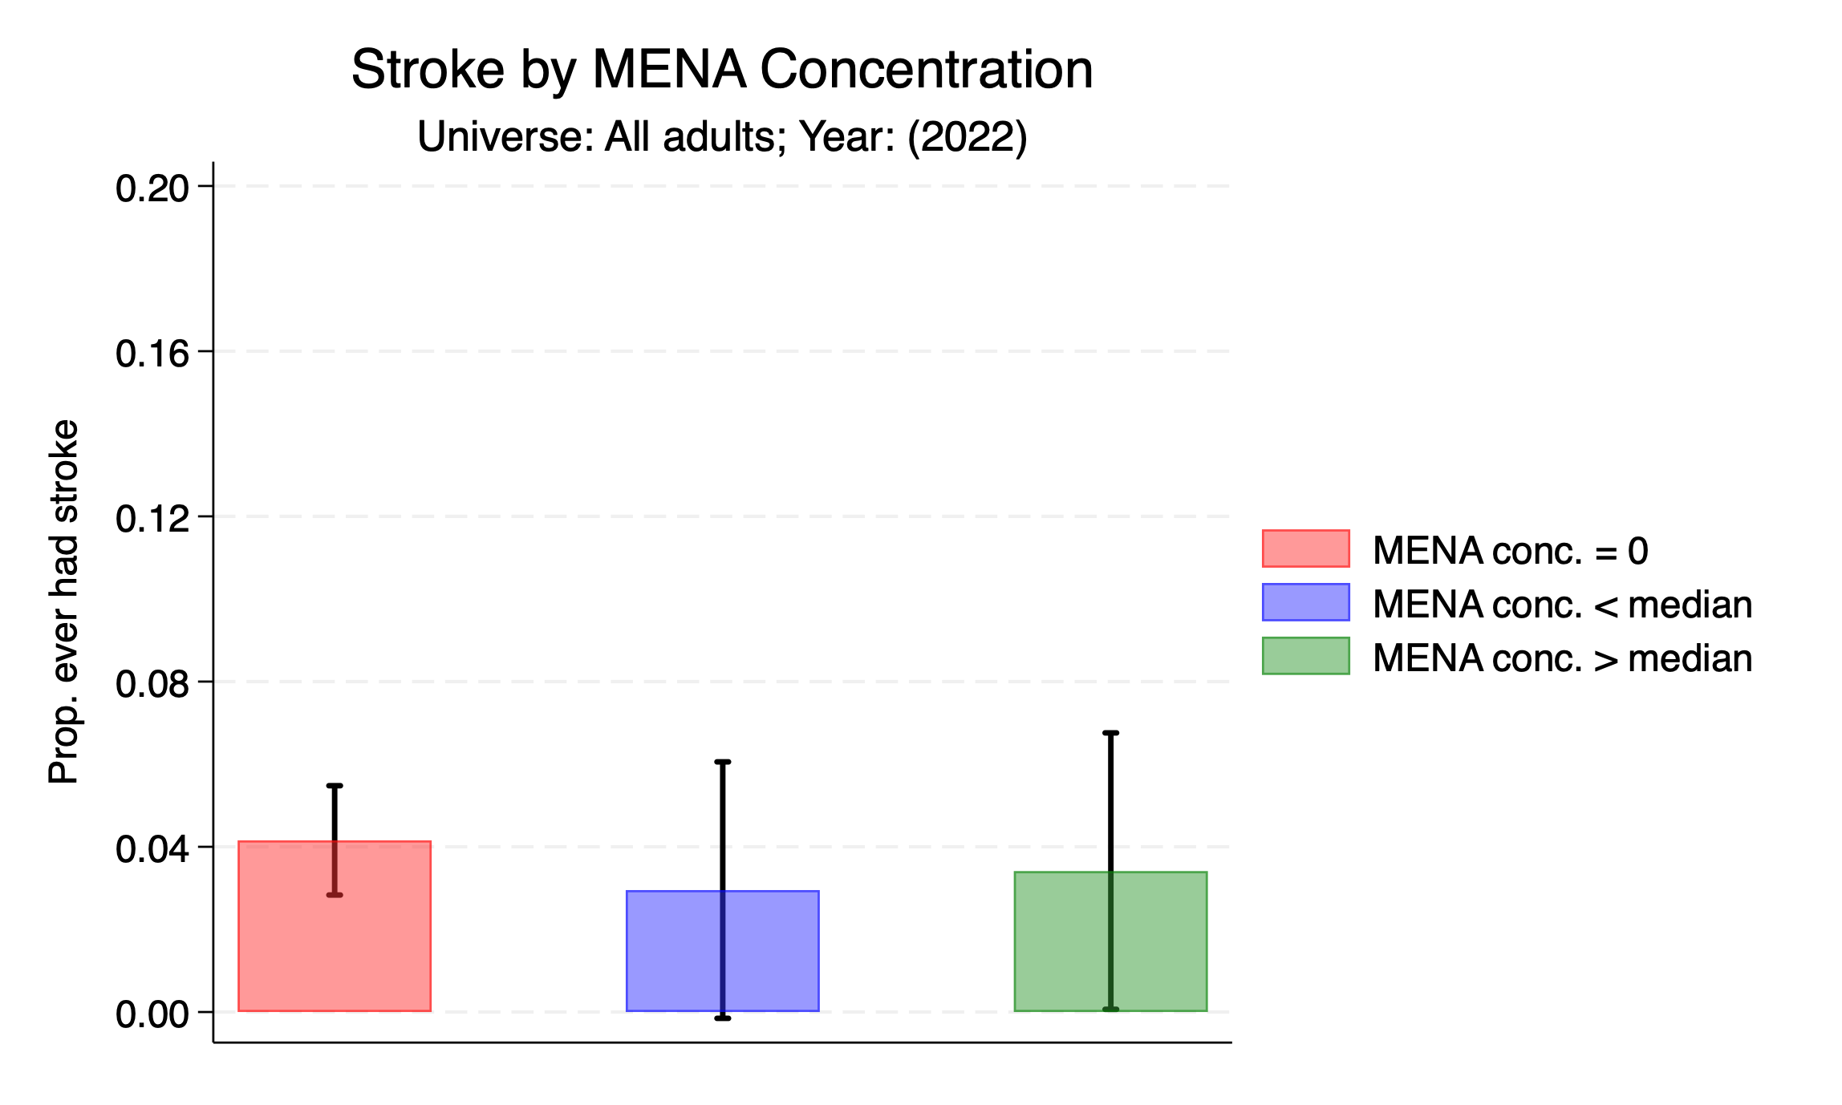

Slide 27
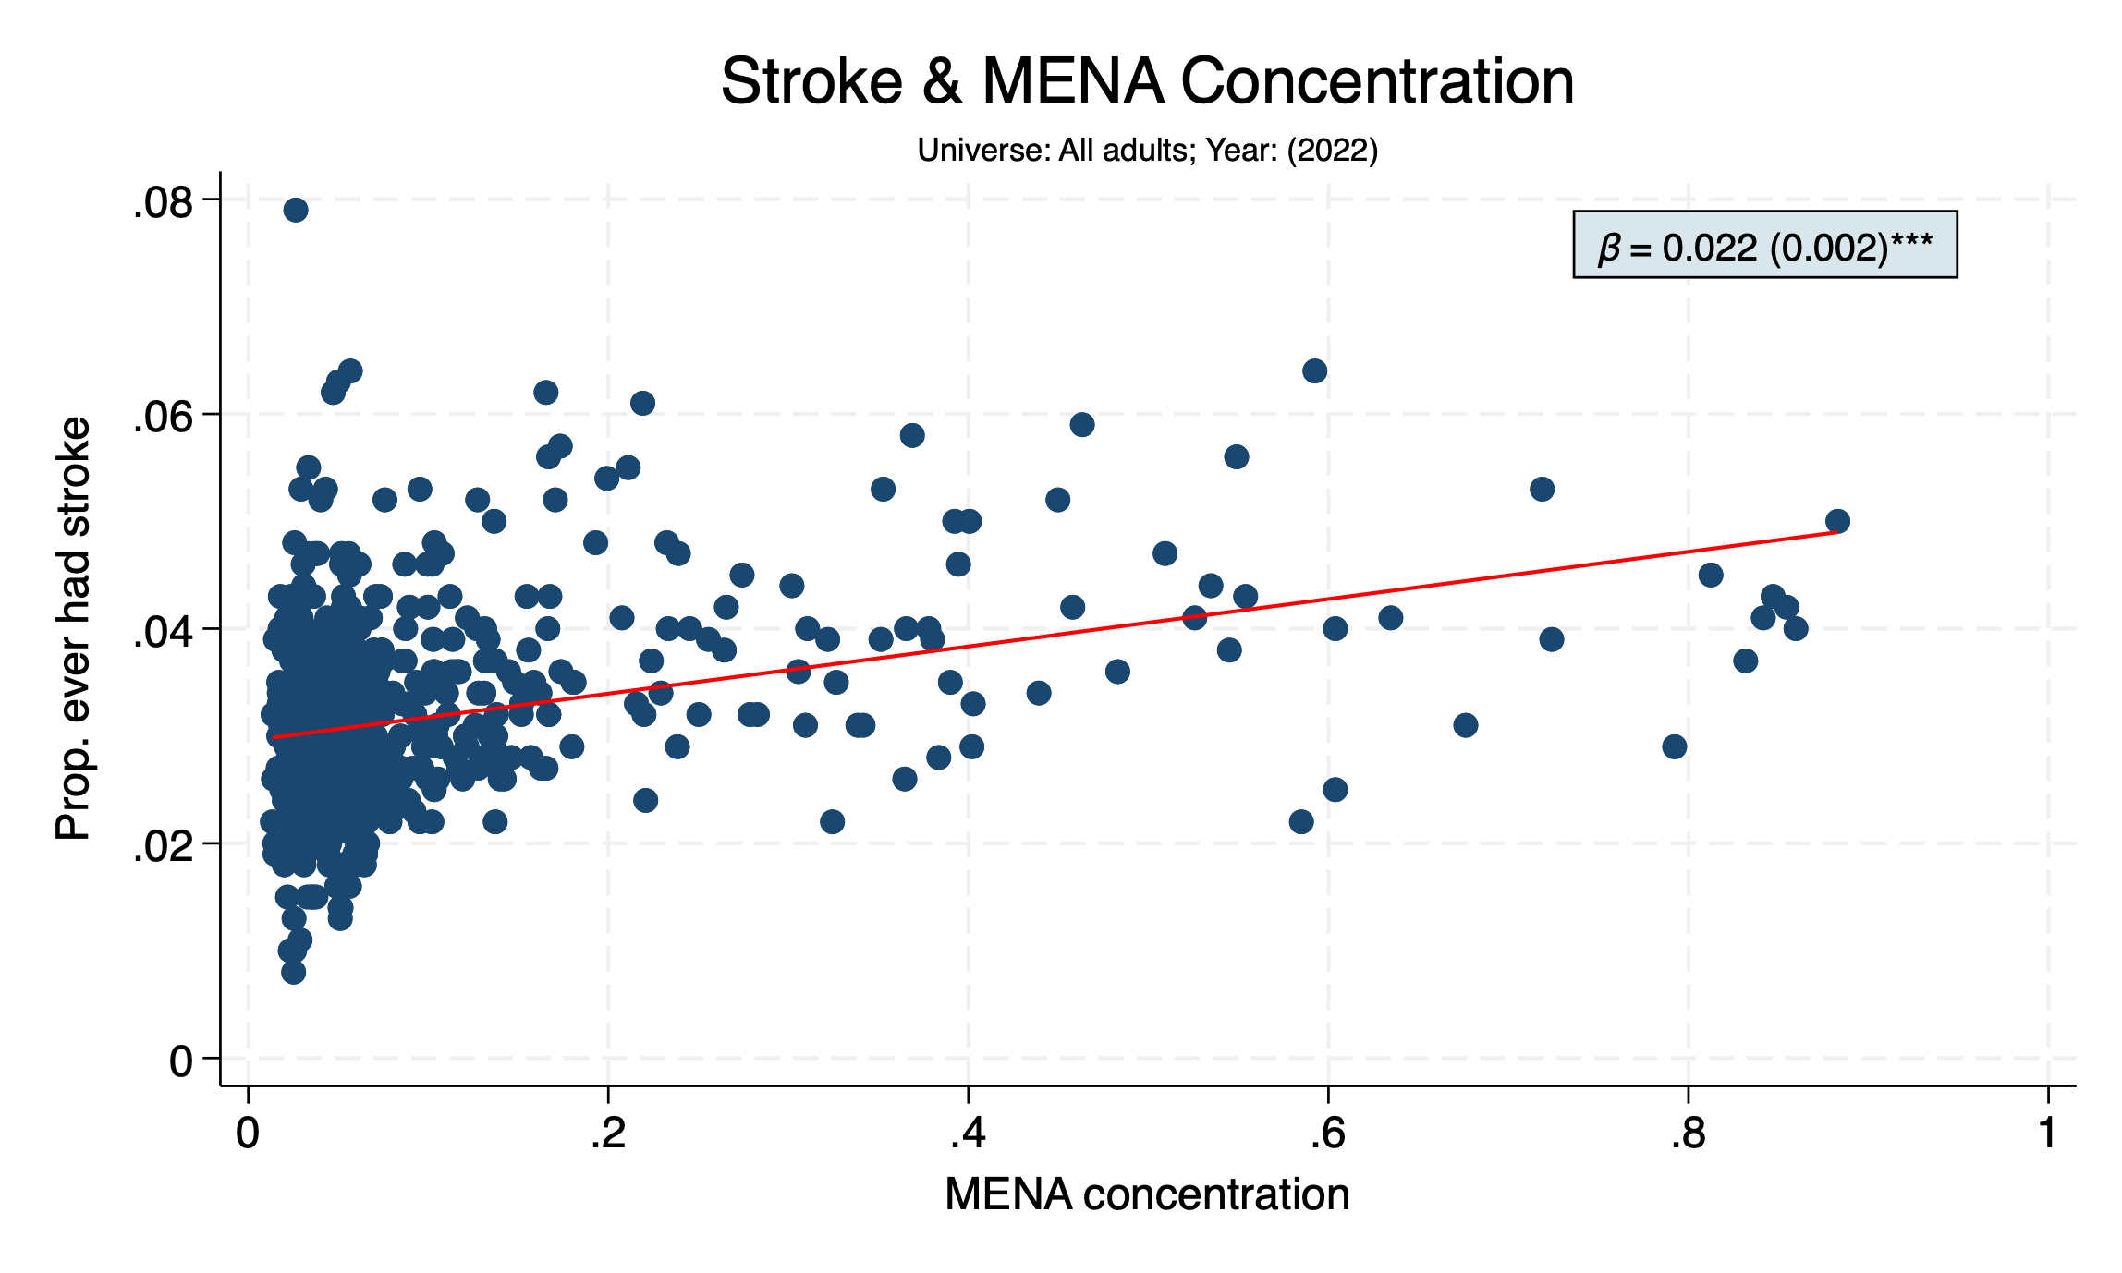

Slide 28
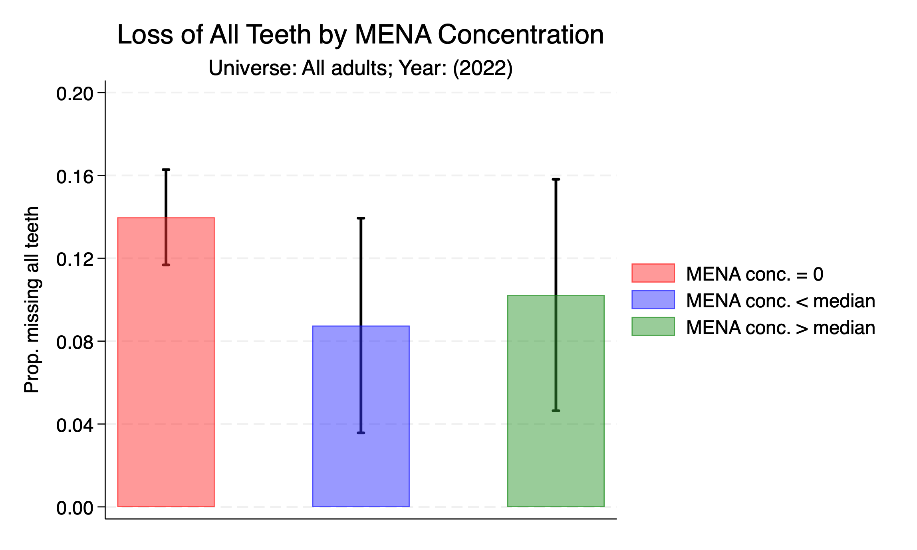

Slide 29
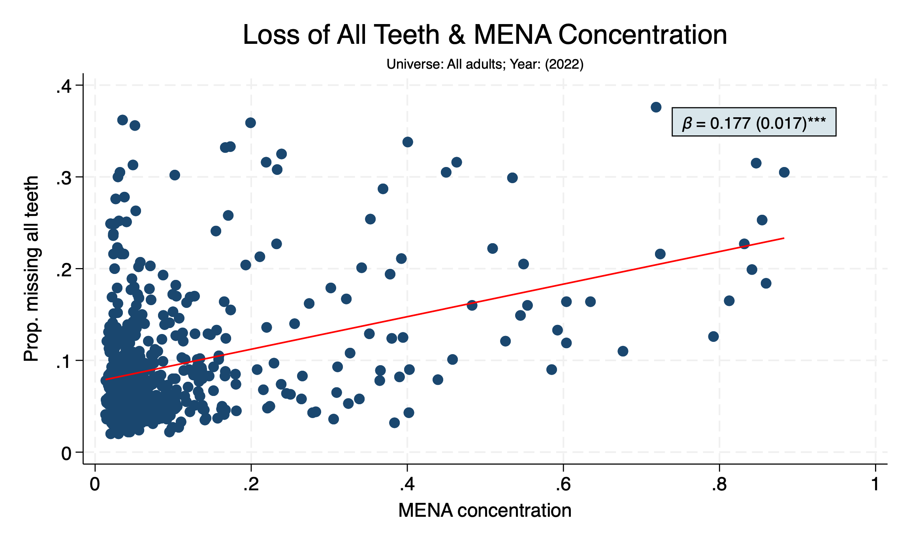

Slide 30
UTILIZATION OF PREVENTIVE CARE

Slide 31
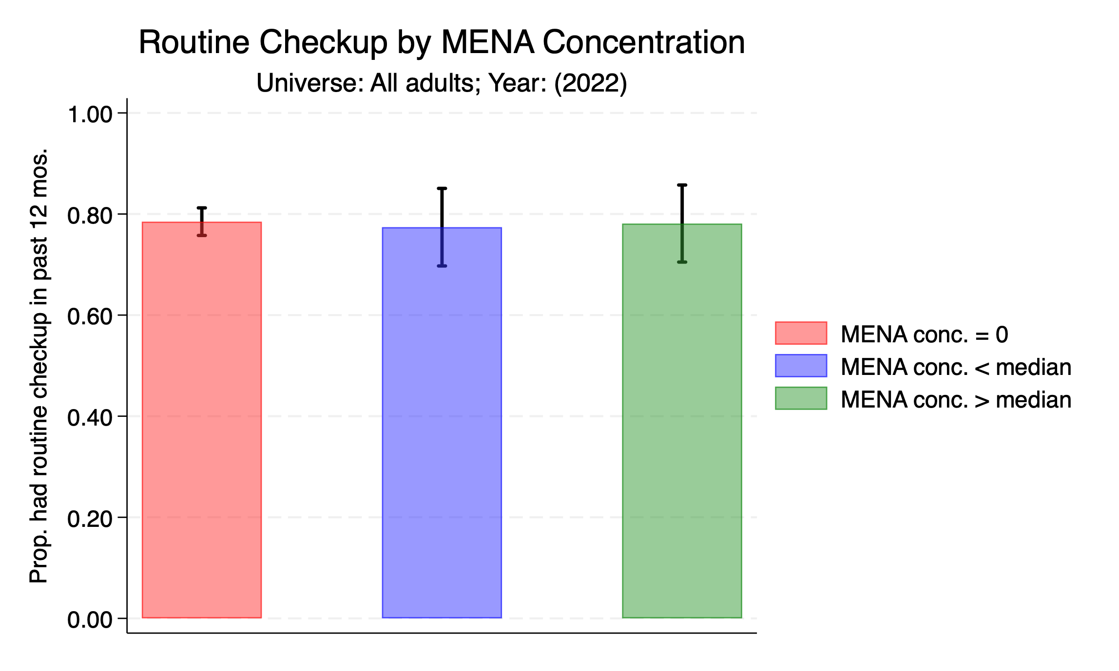

Slide 32
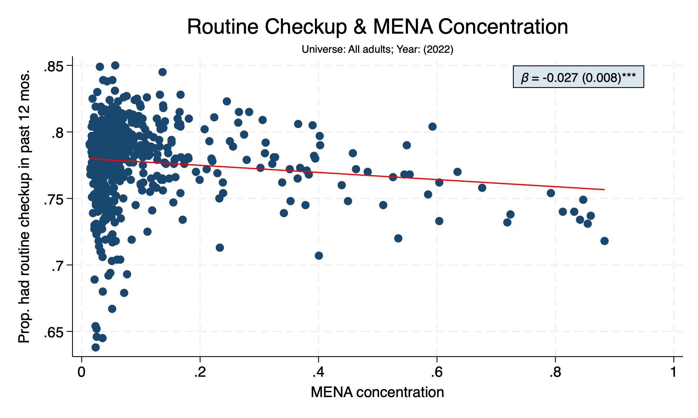

Slide 33
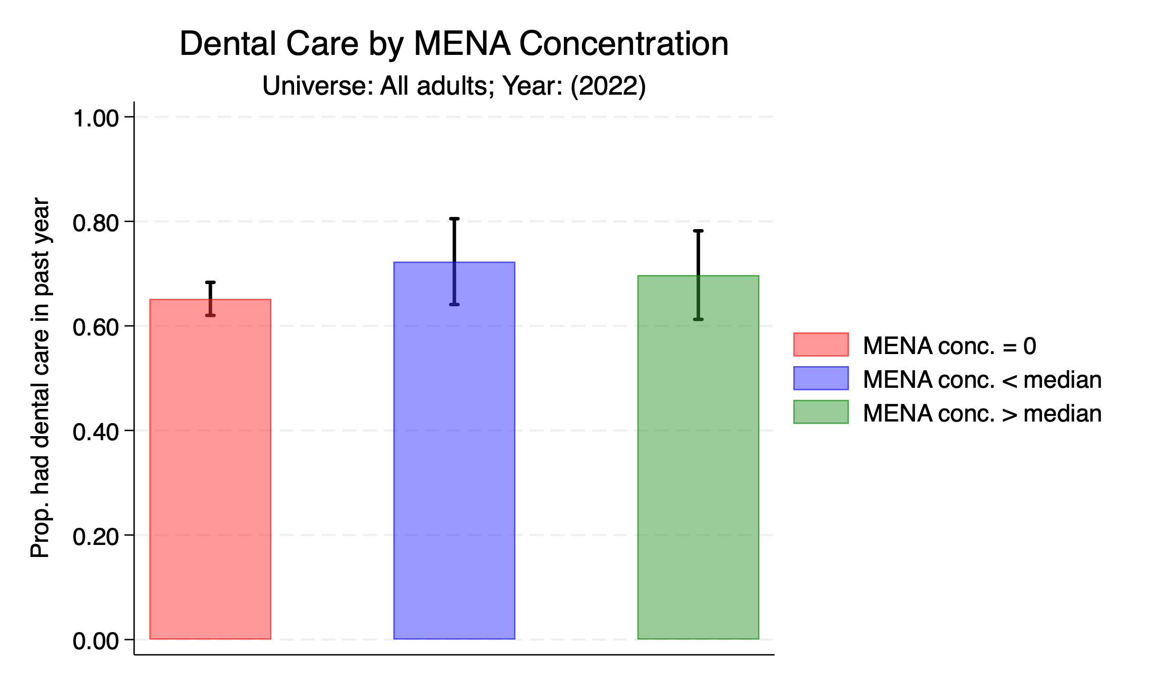

Slide 34
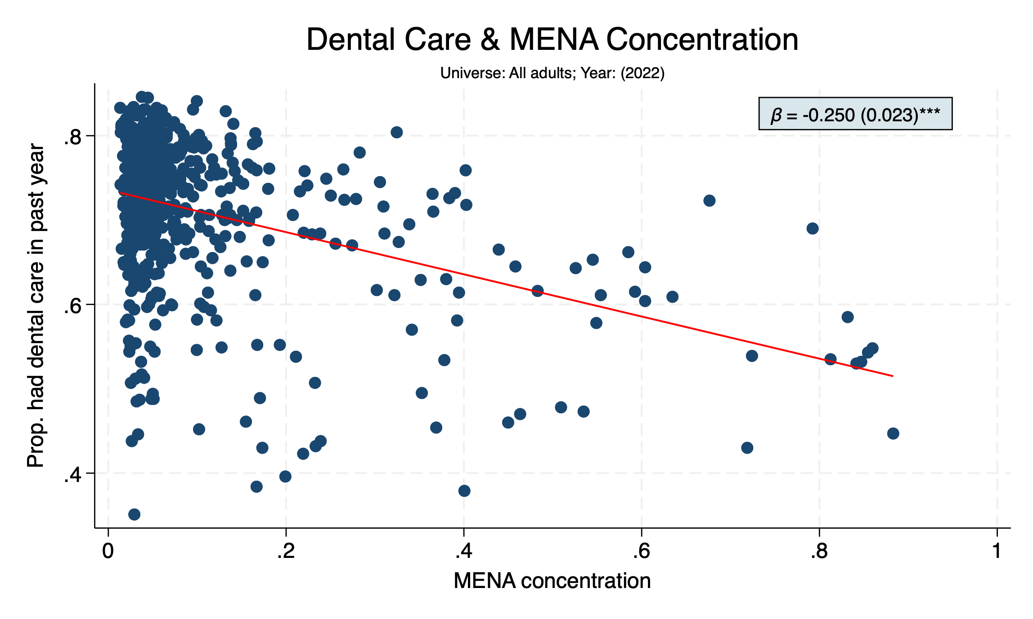

Slide 35
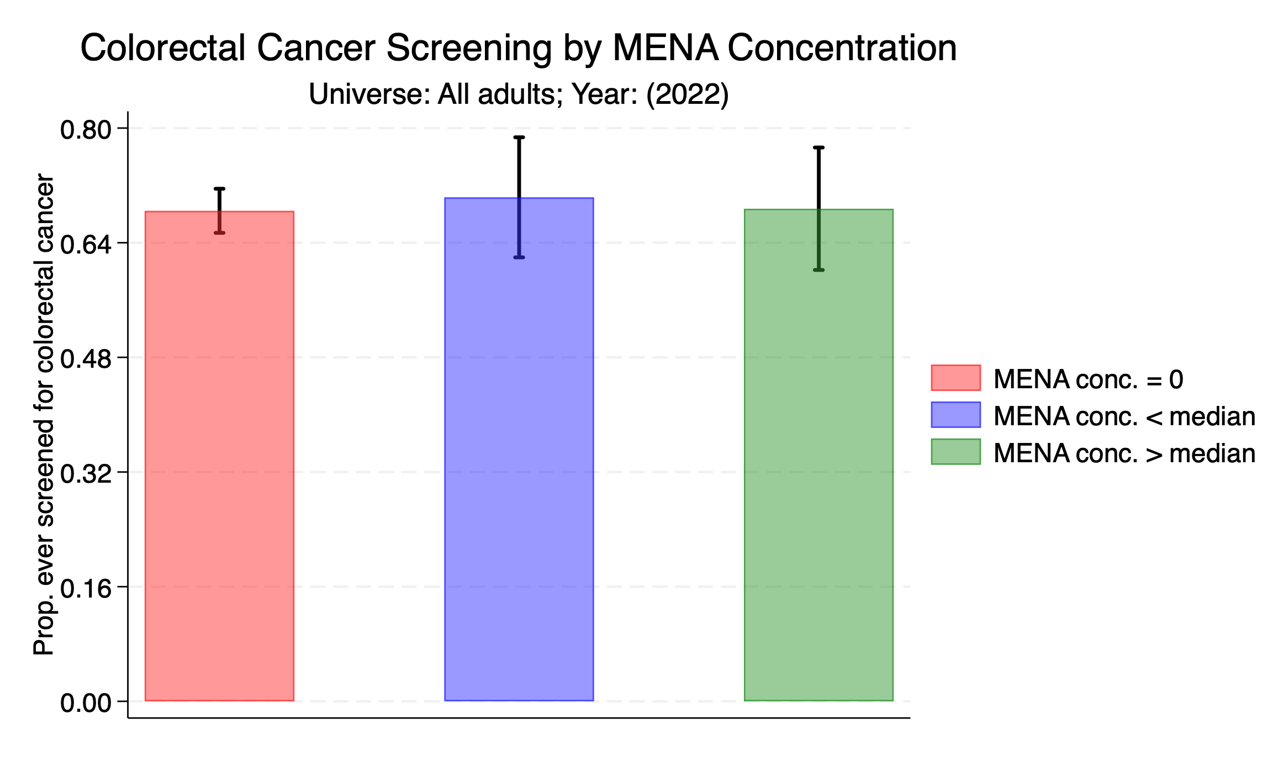

Slide 36
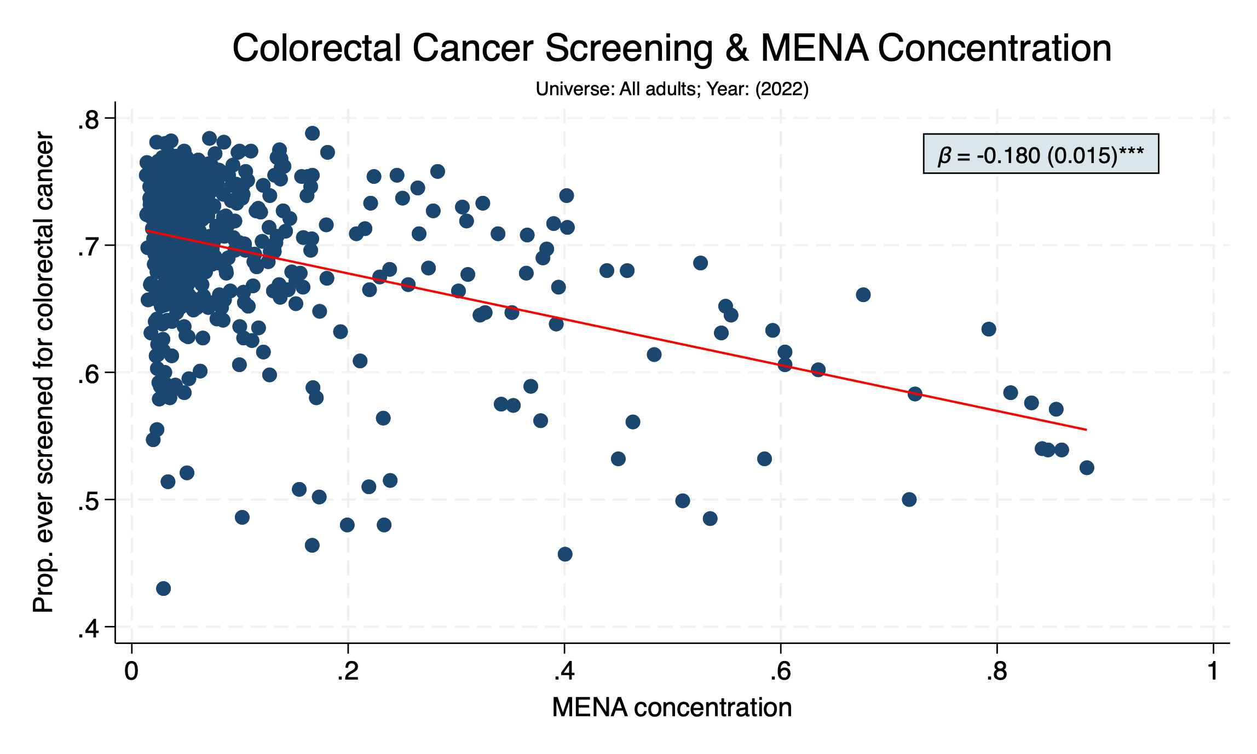

Slide 37
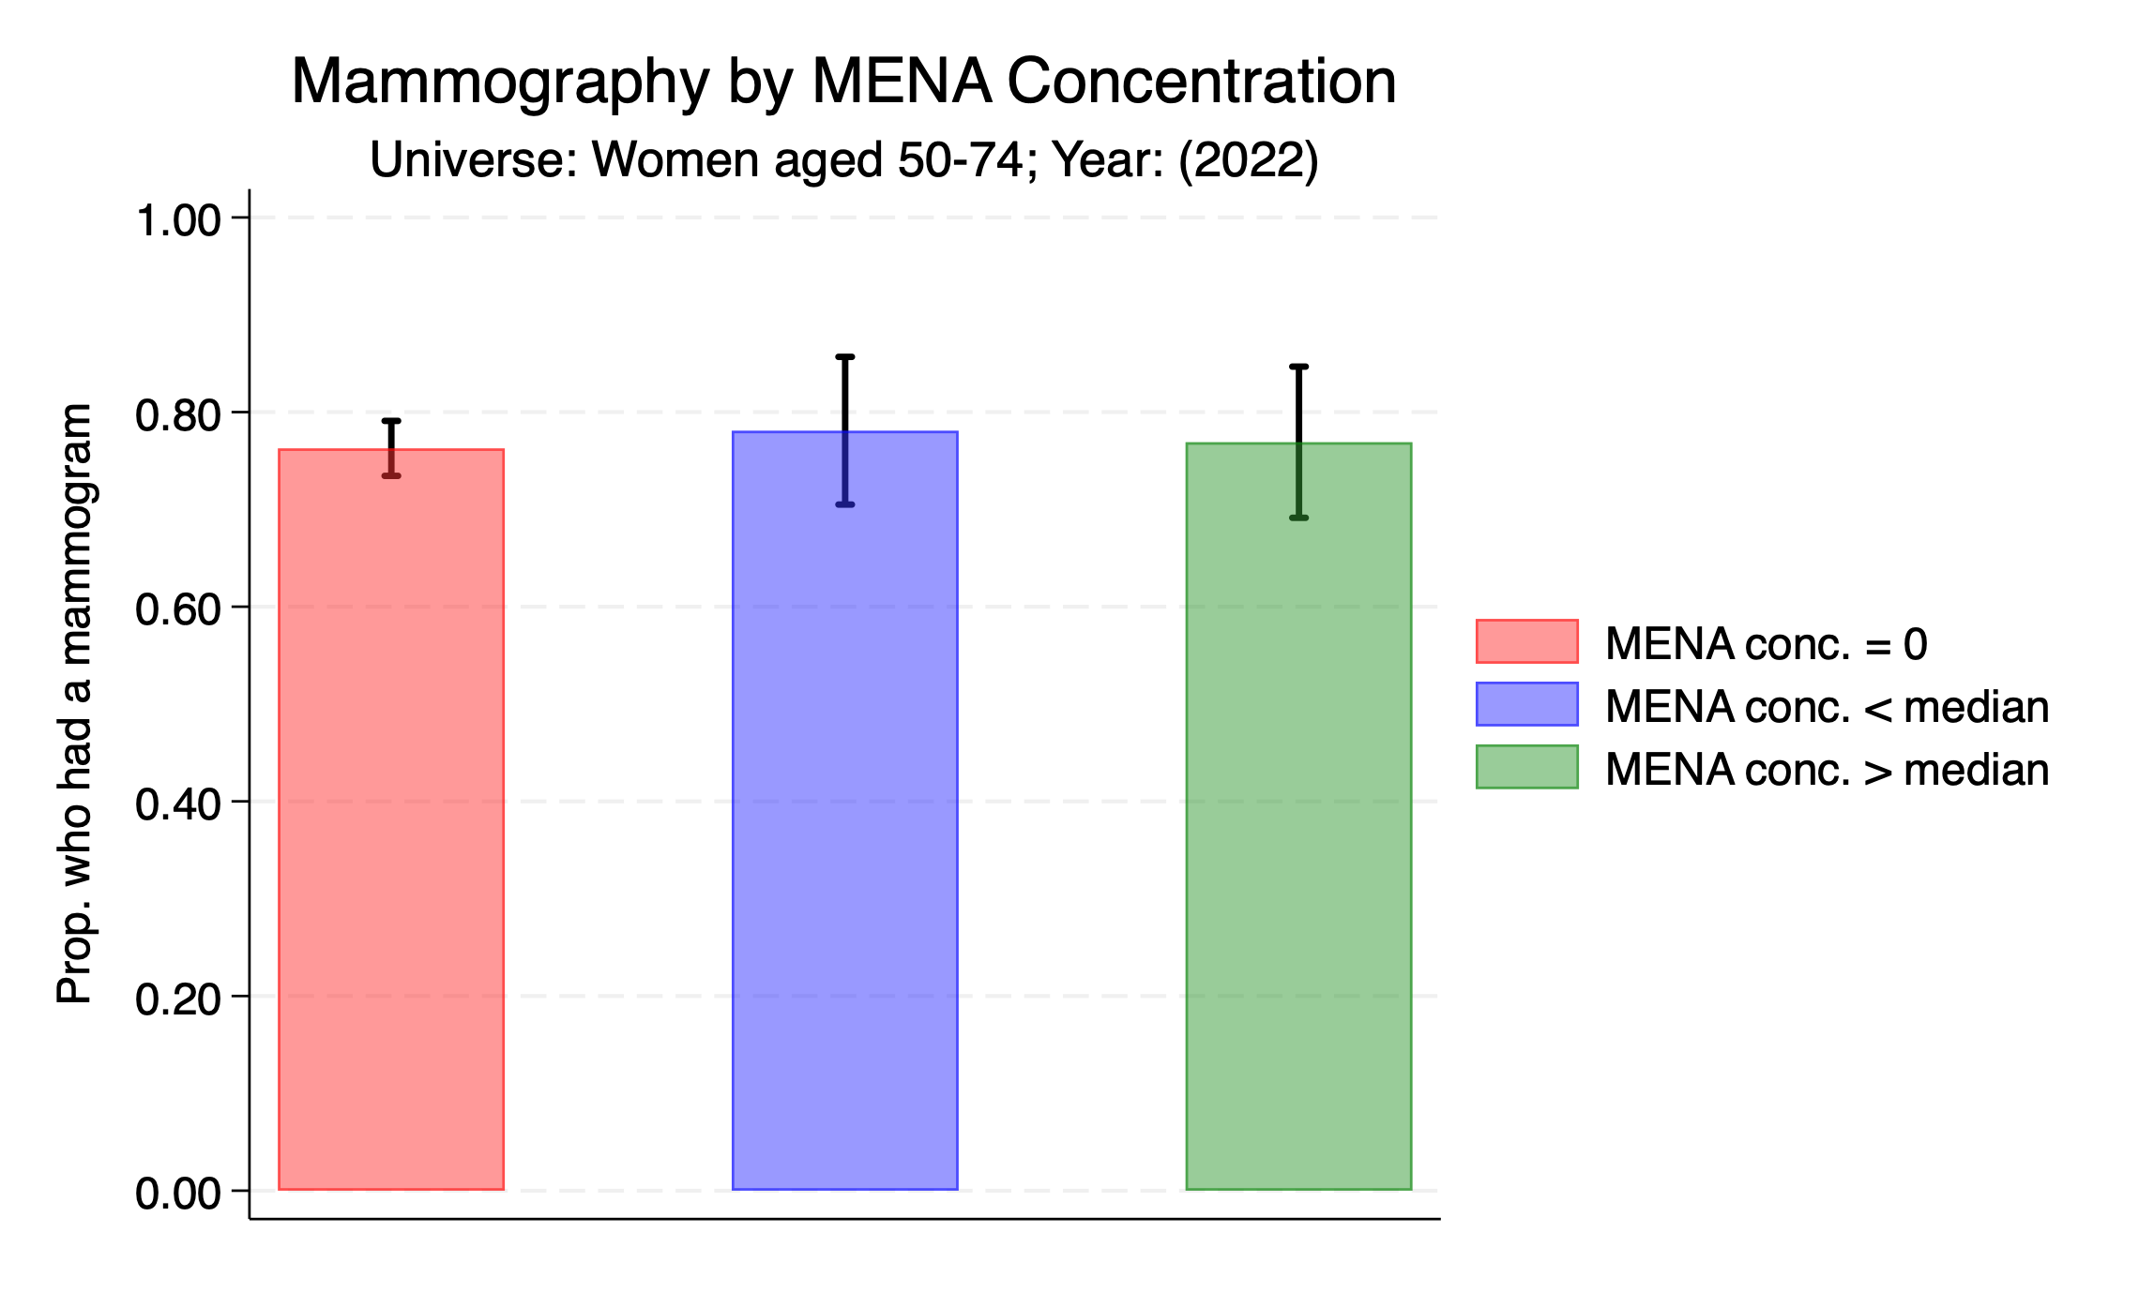

Slide 38
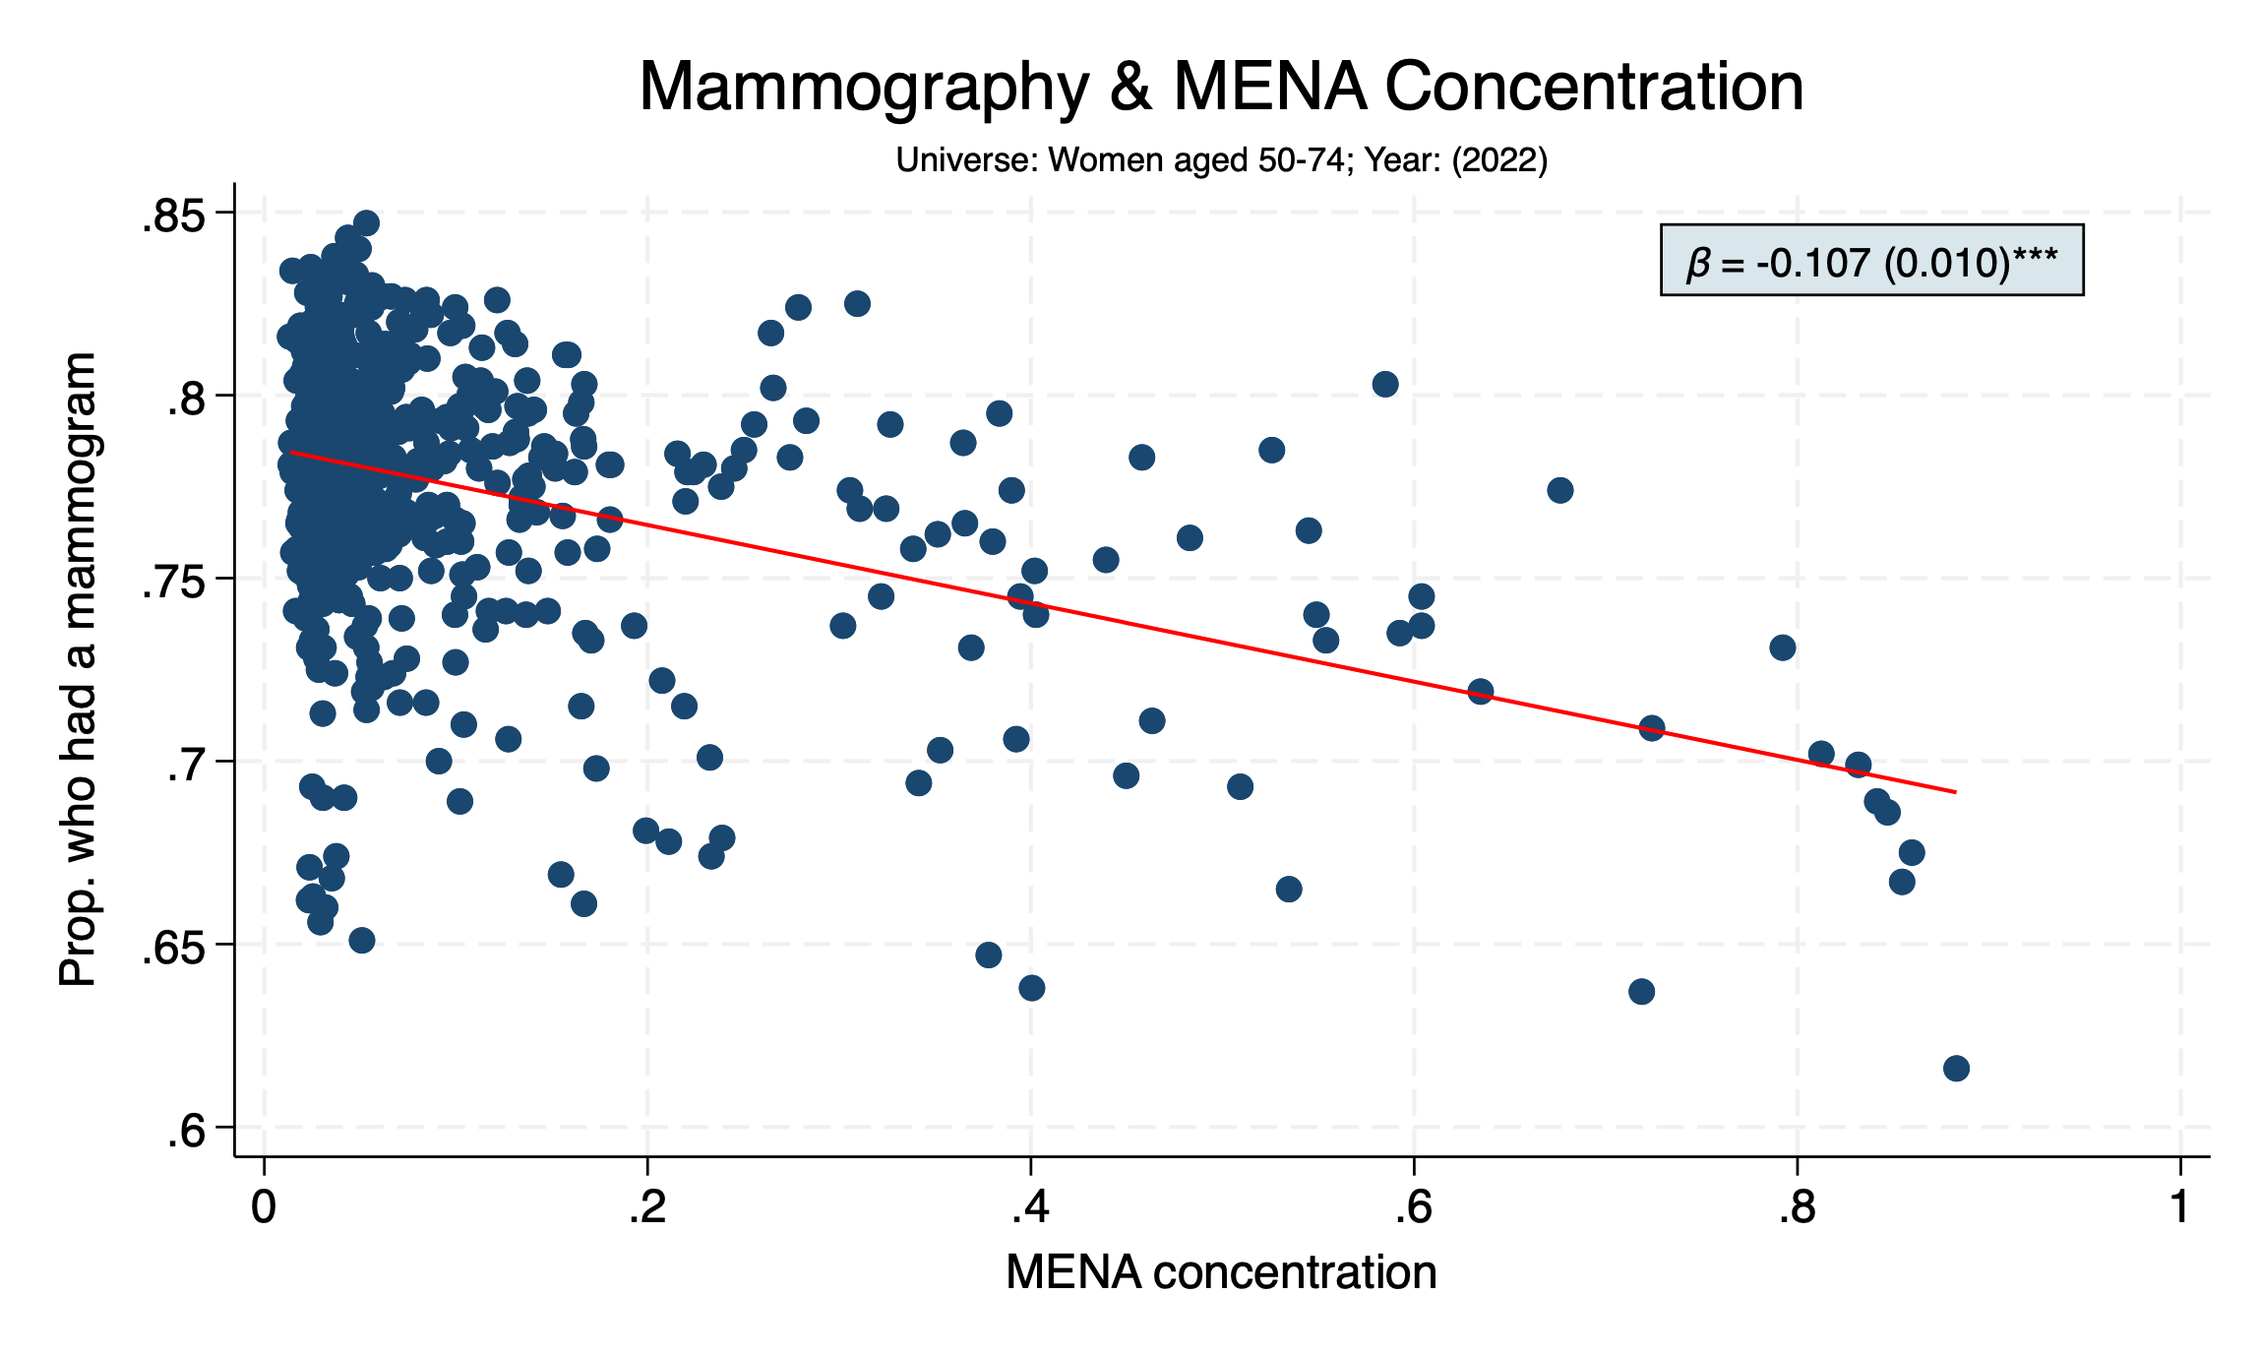

Slide 39
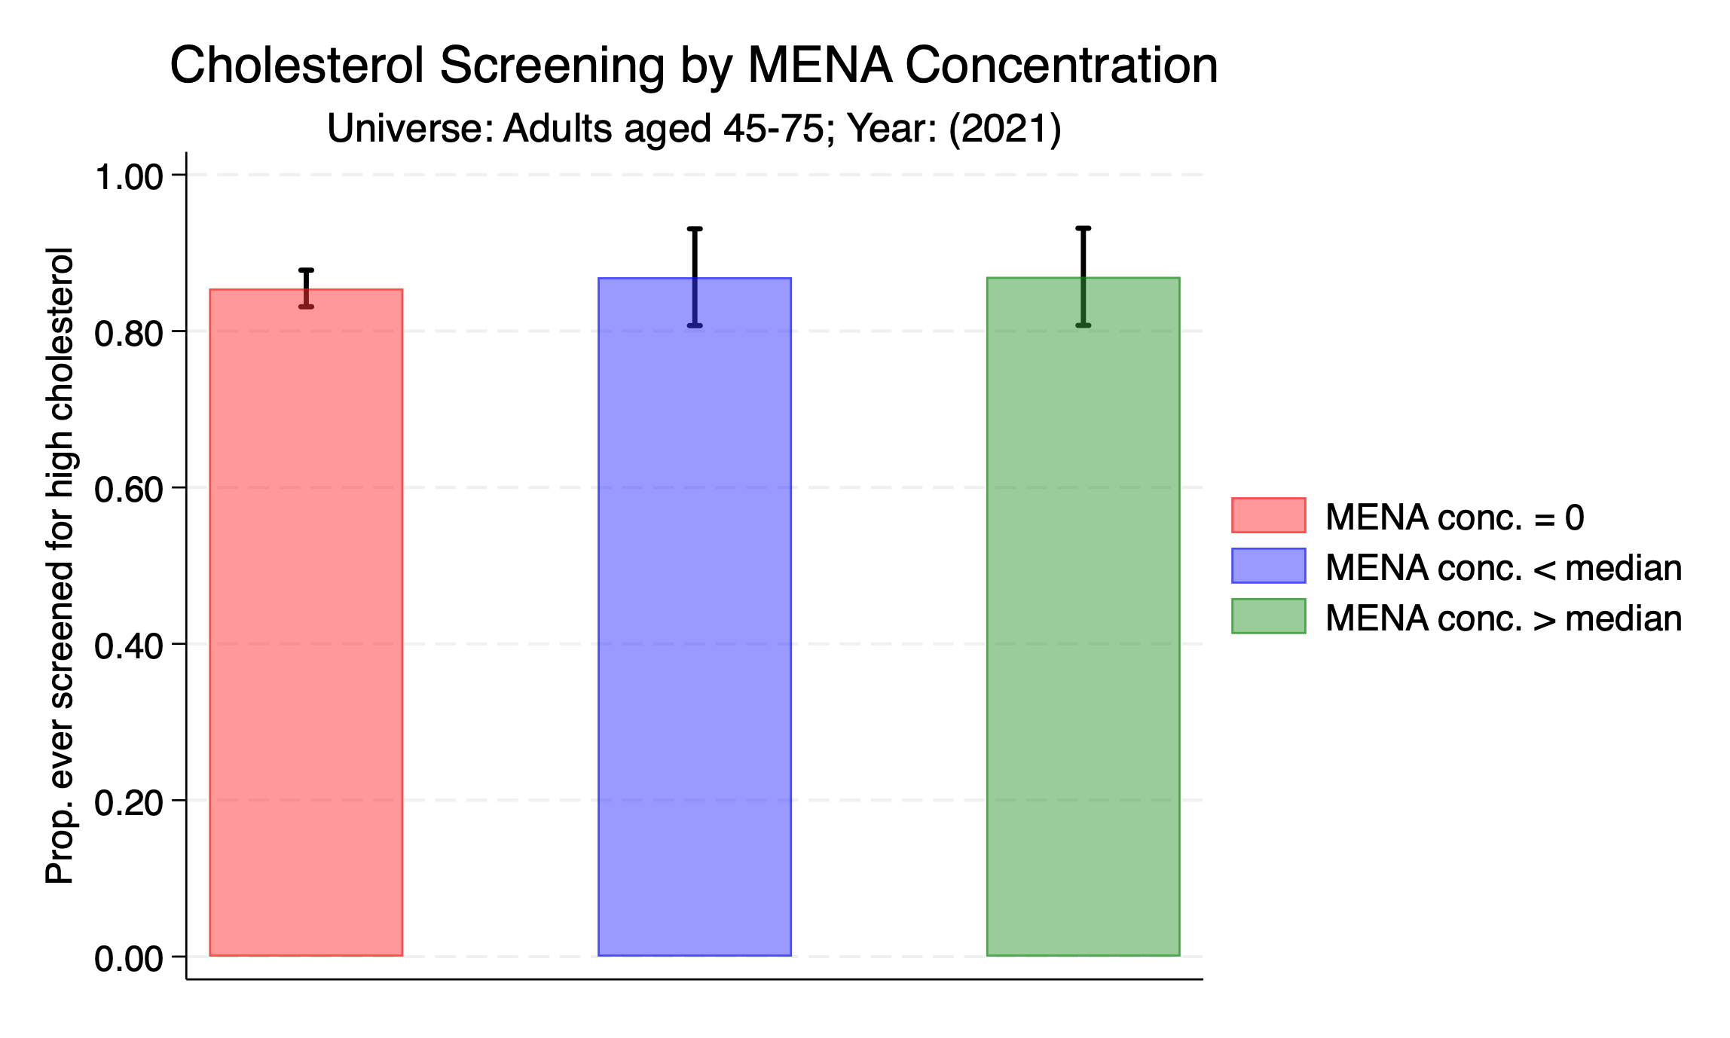

Slide 40
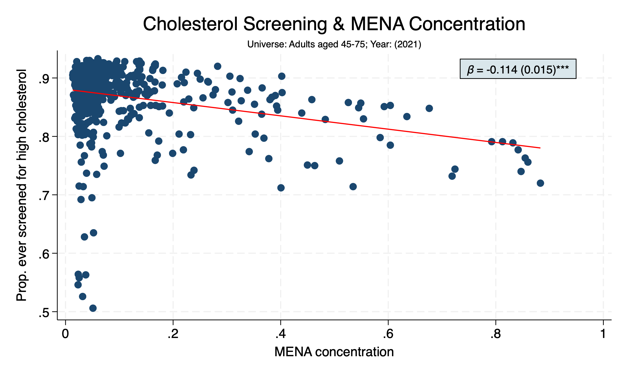

Slide 41
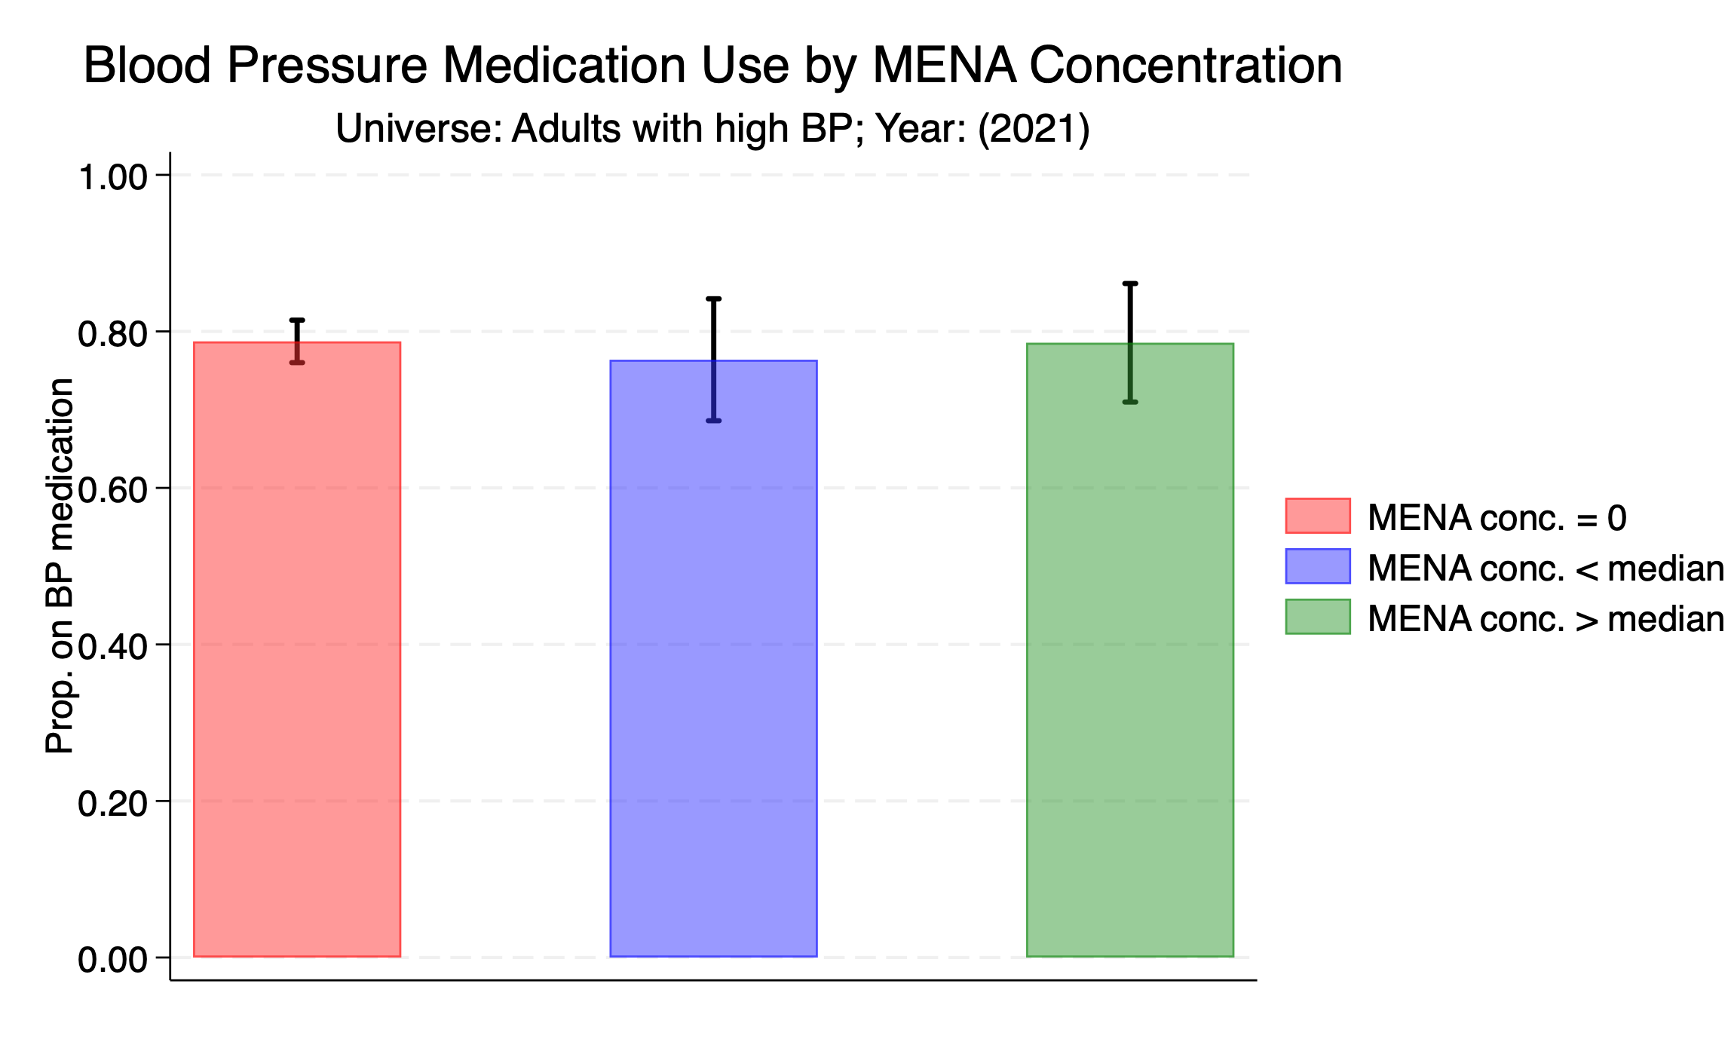

Slide 42
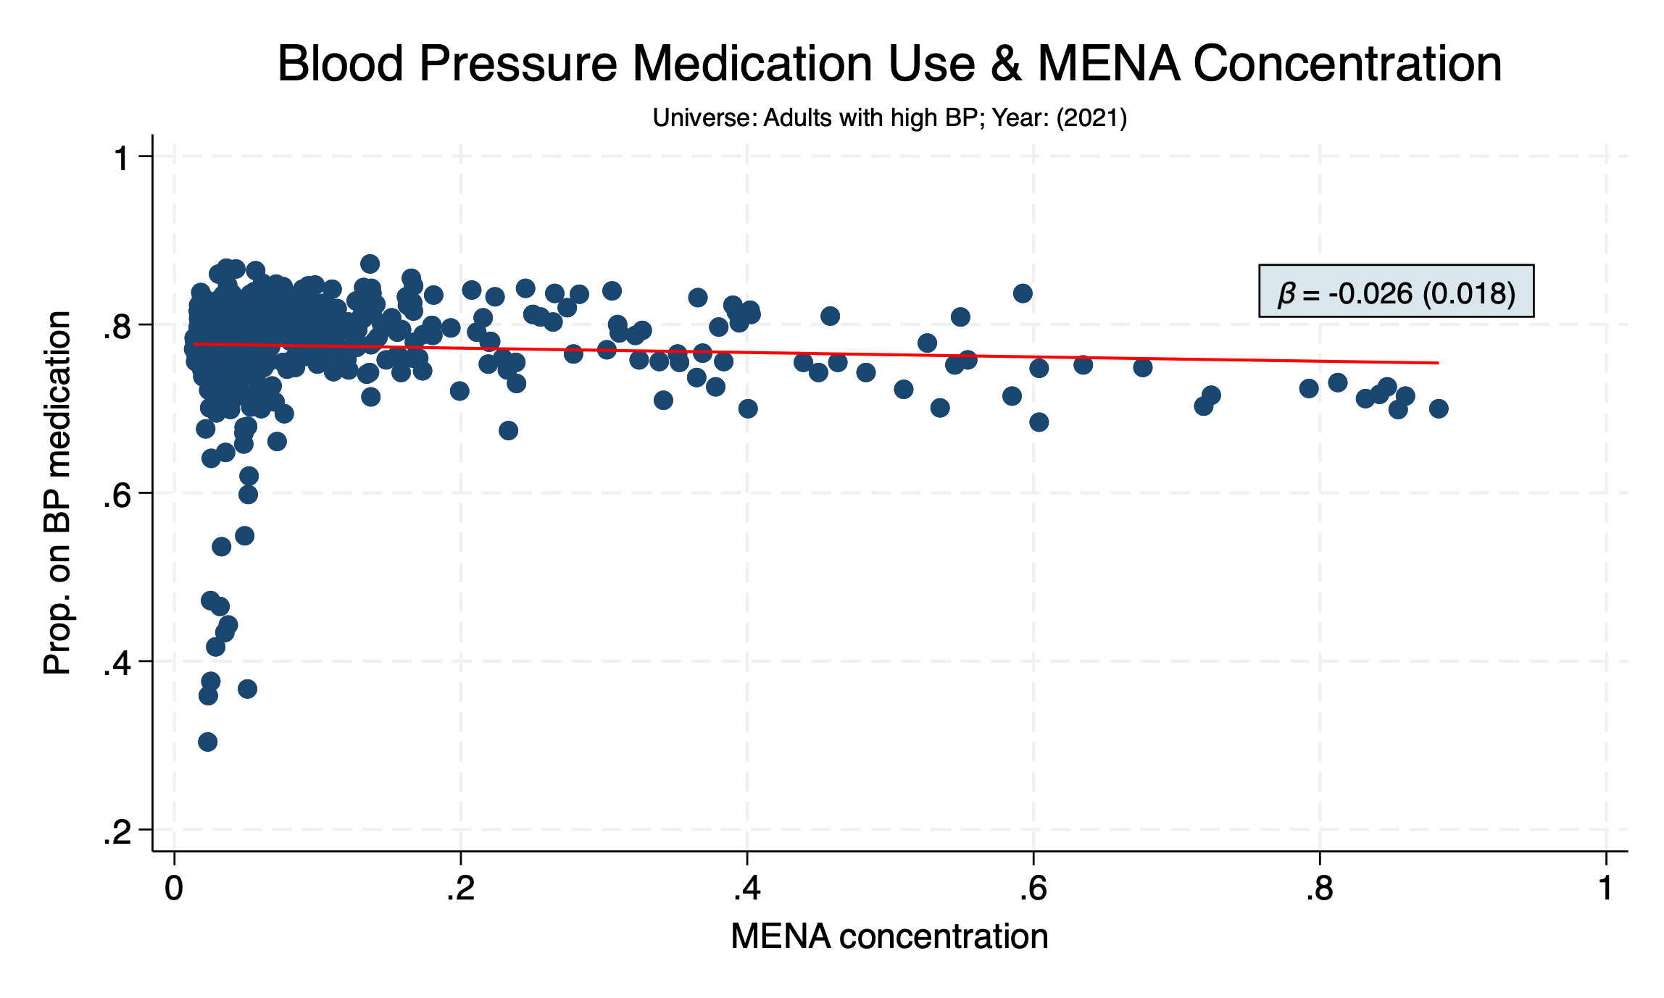

Slide 43
DISABILITY

Slide 44
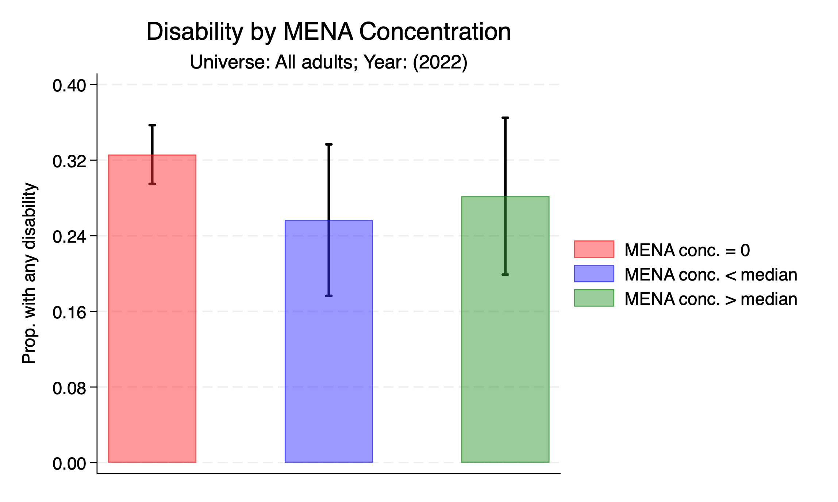

Slide 45
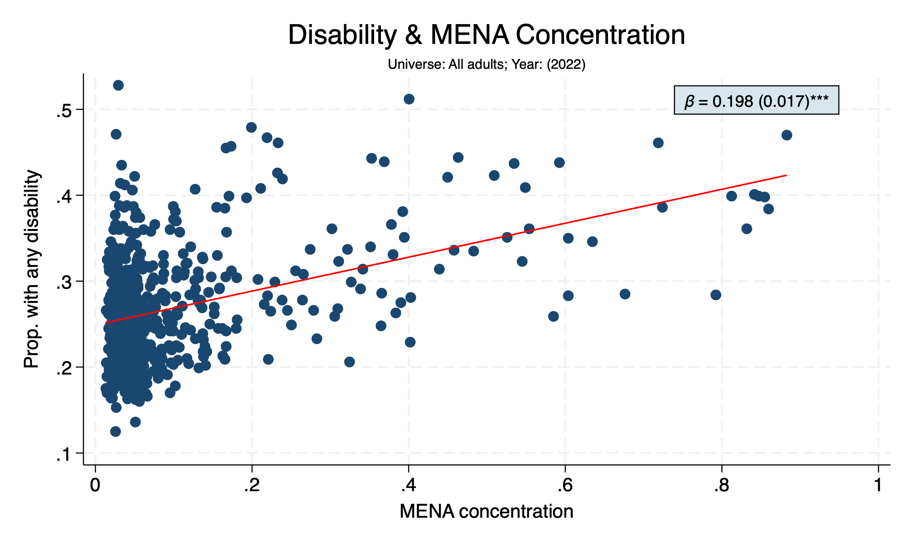

Slide 46
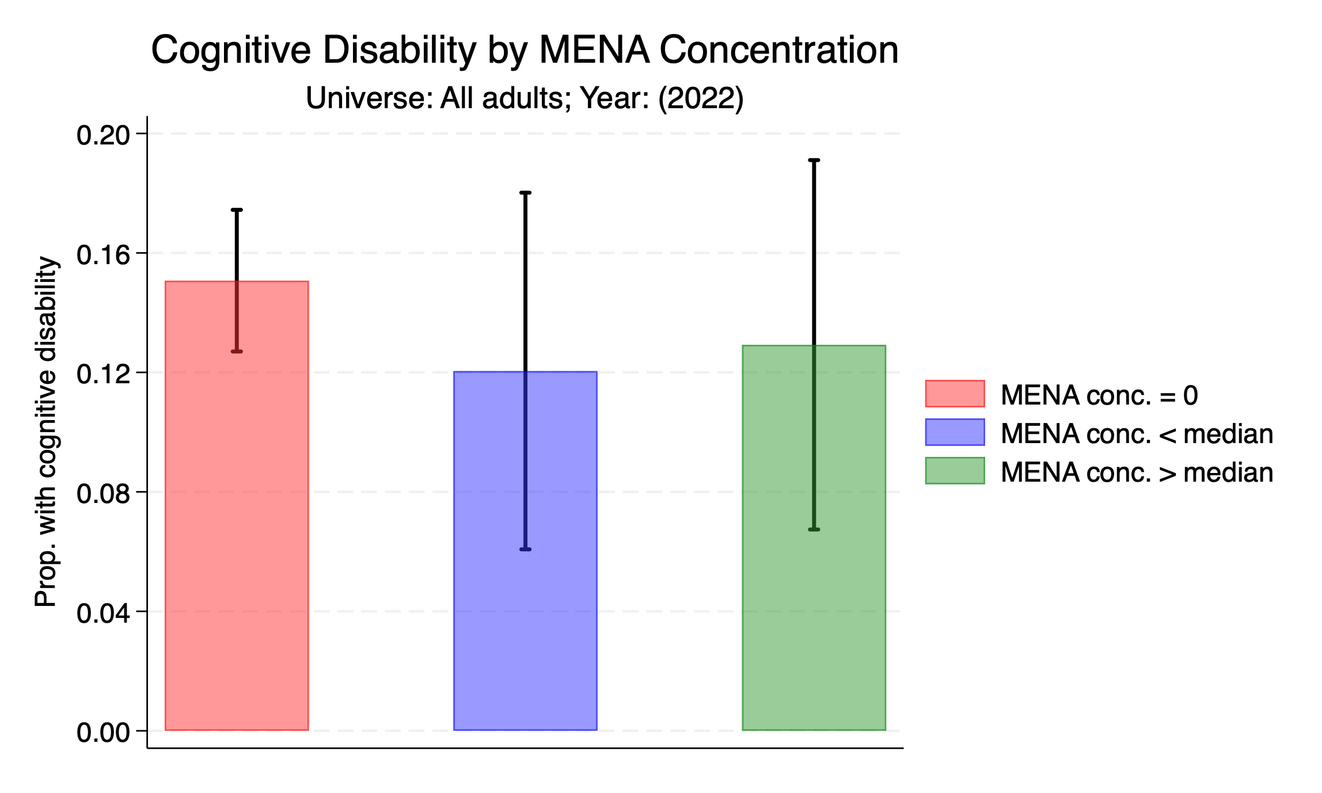

Slide 47
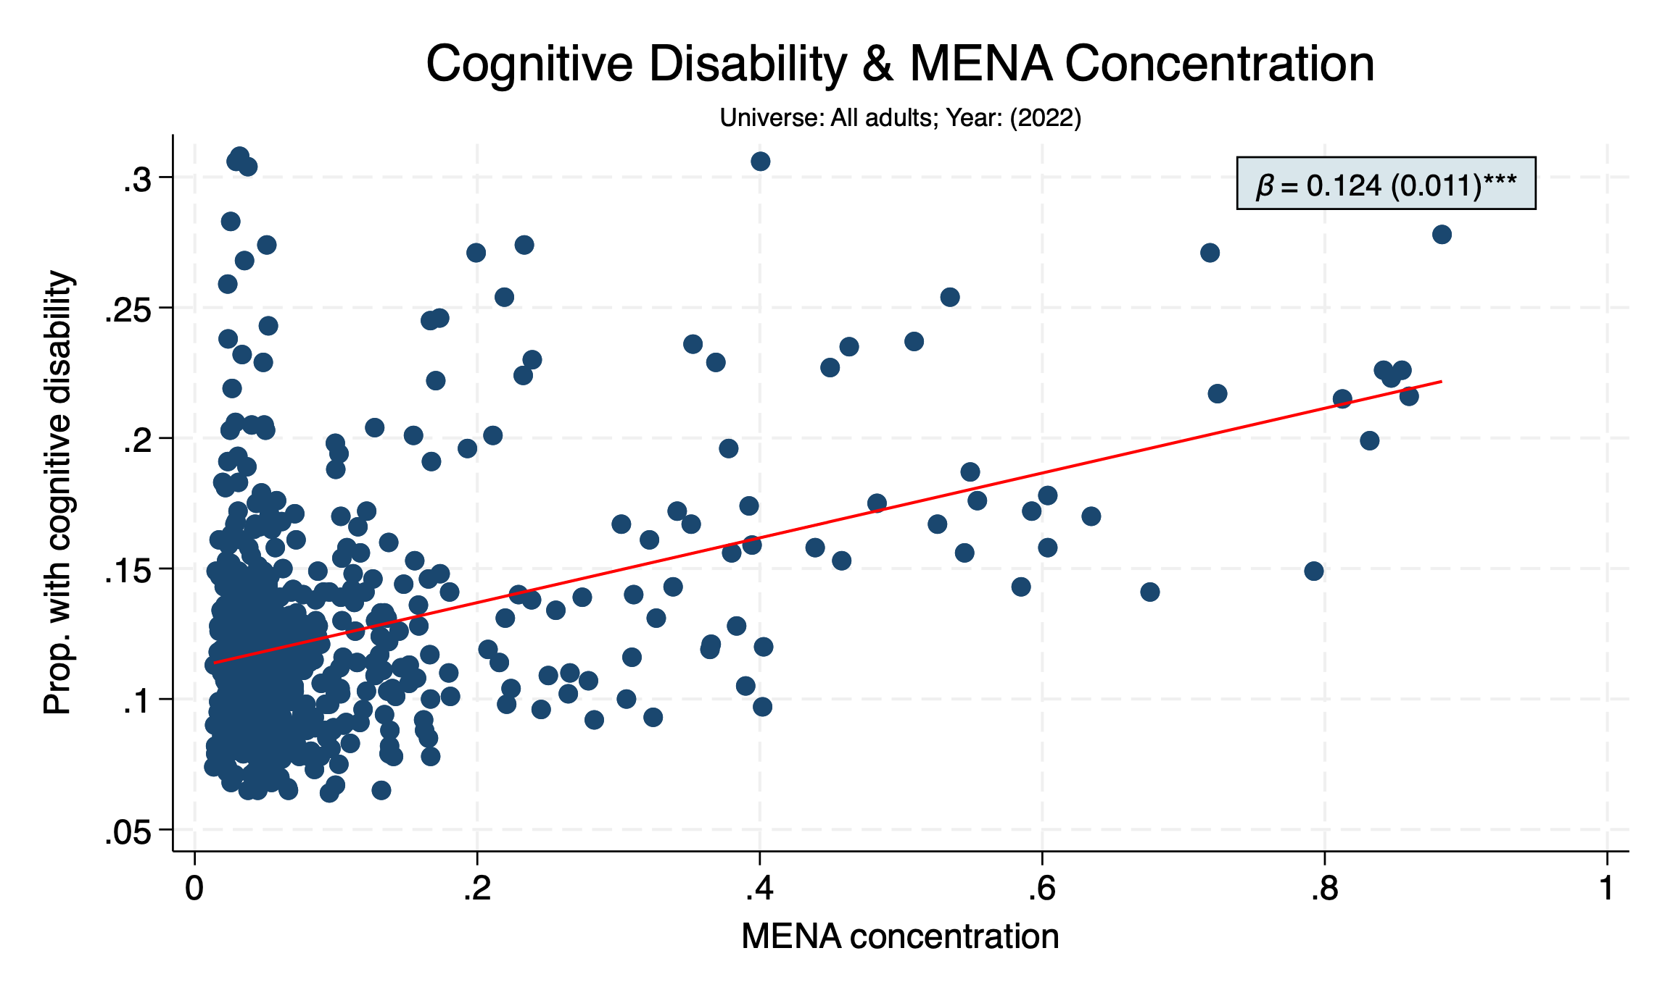

Slide 48
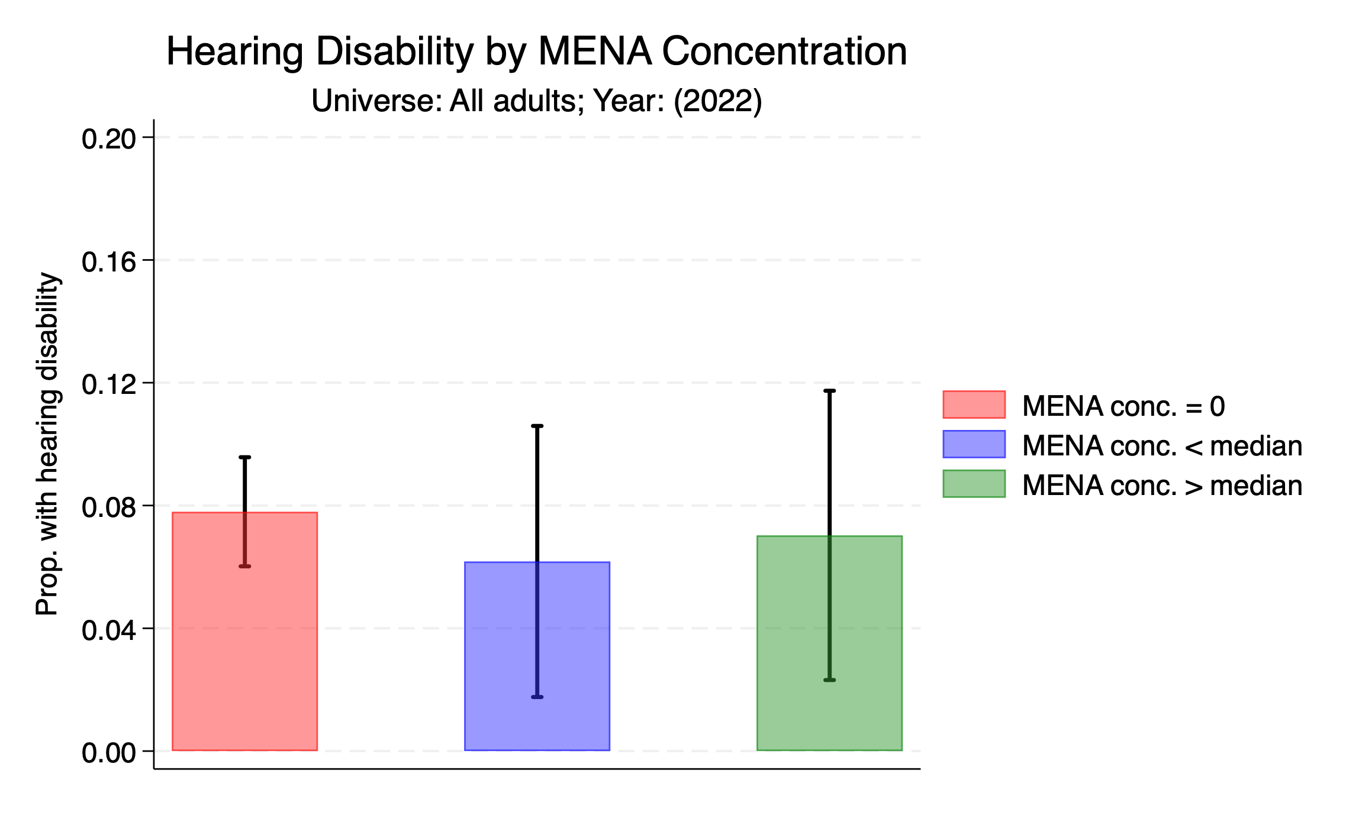

Slide 49
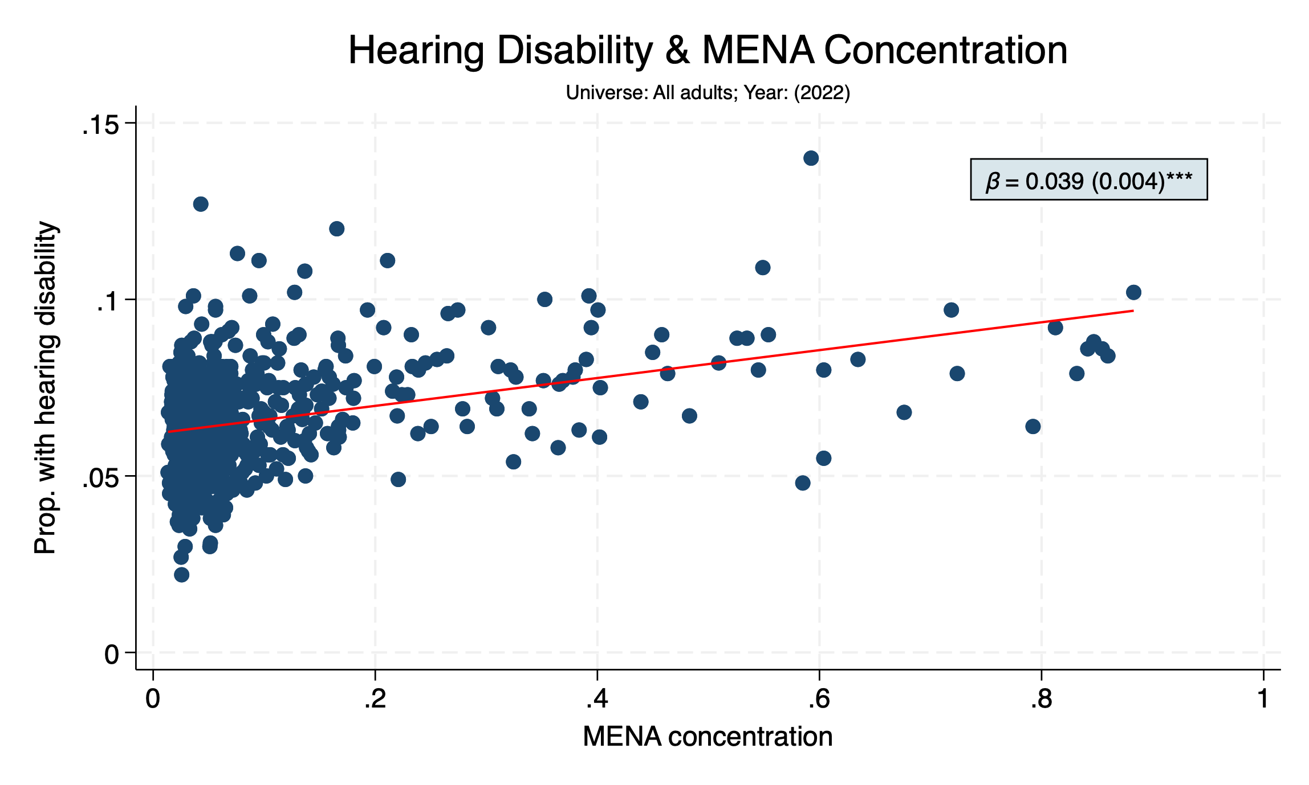

Slide 50
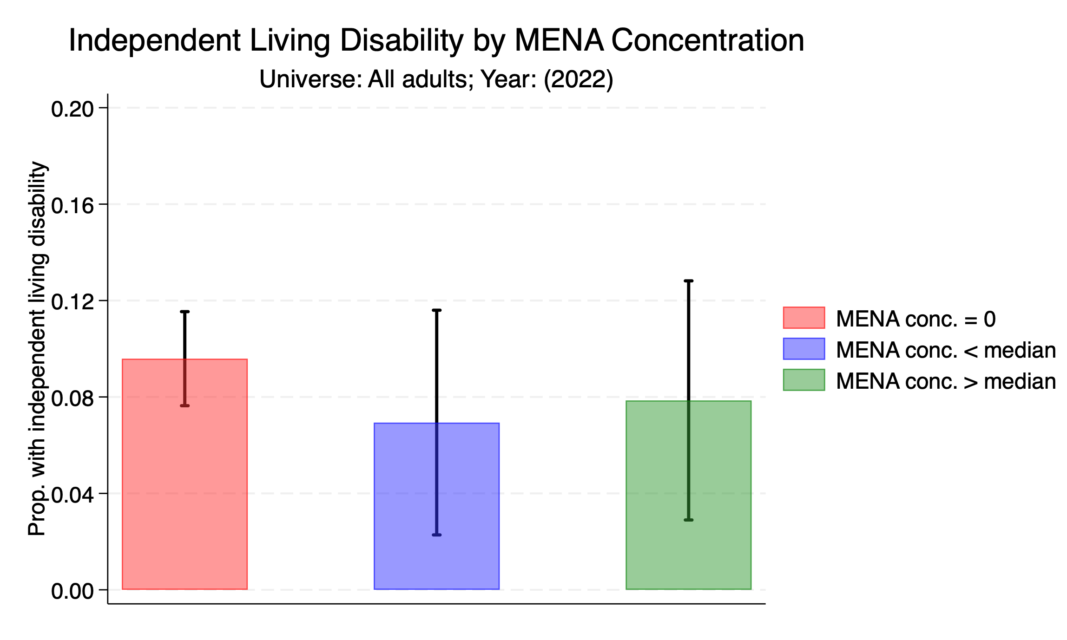

Slide 51
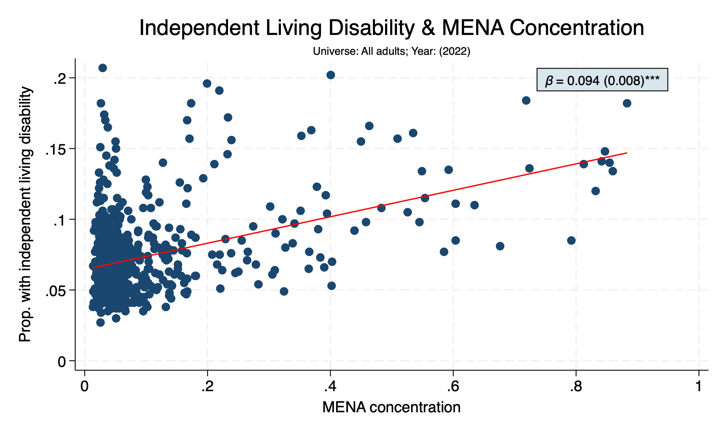

Slide 52
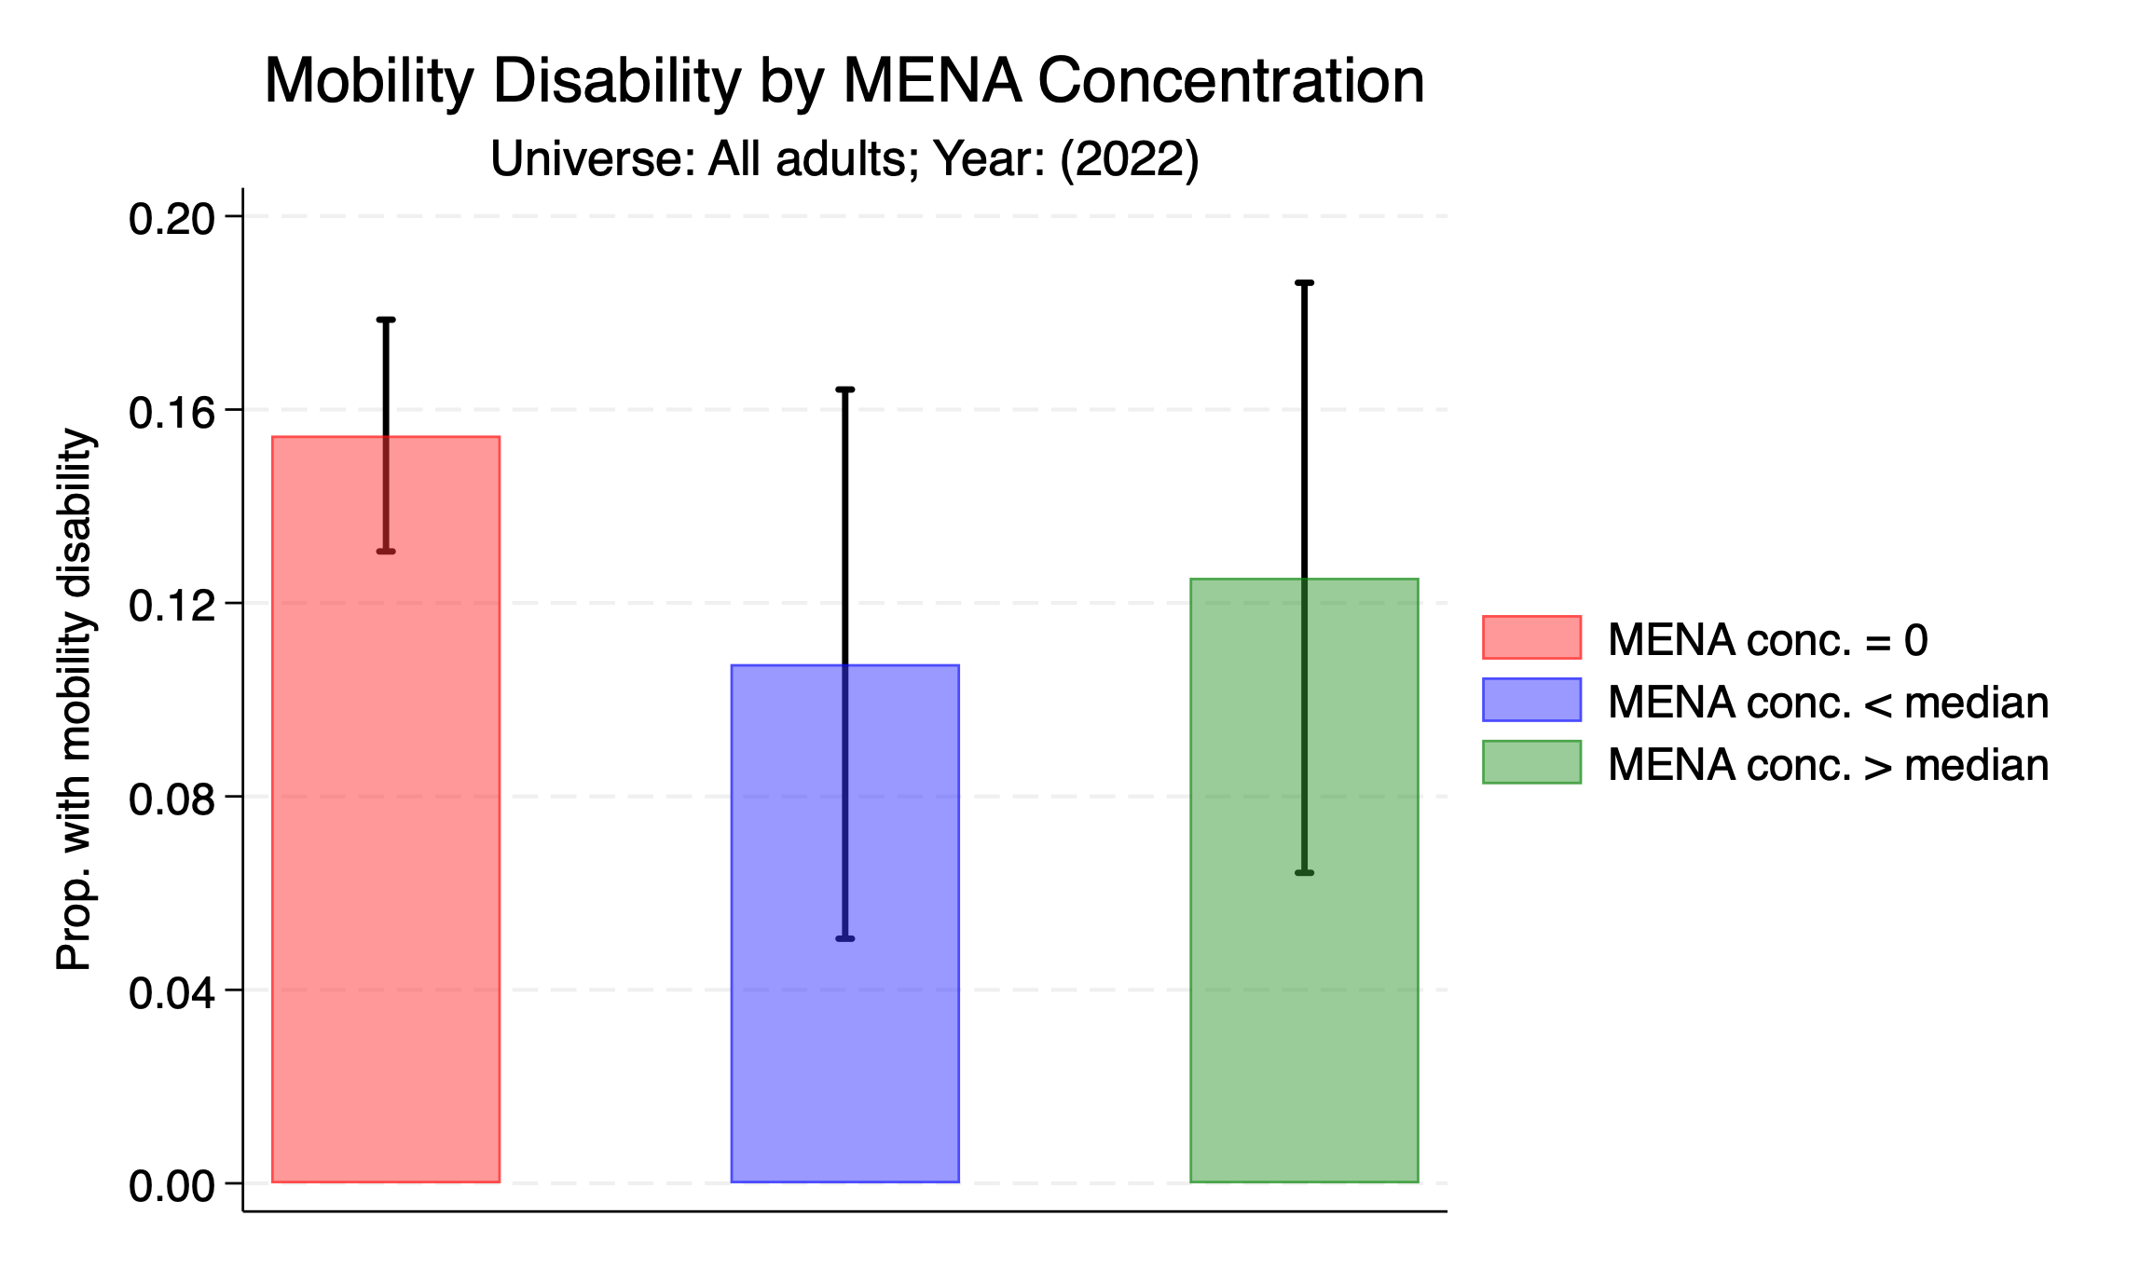

Slide 53
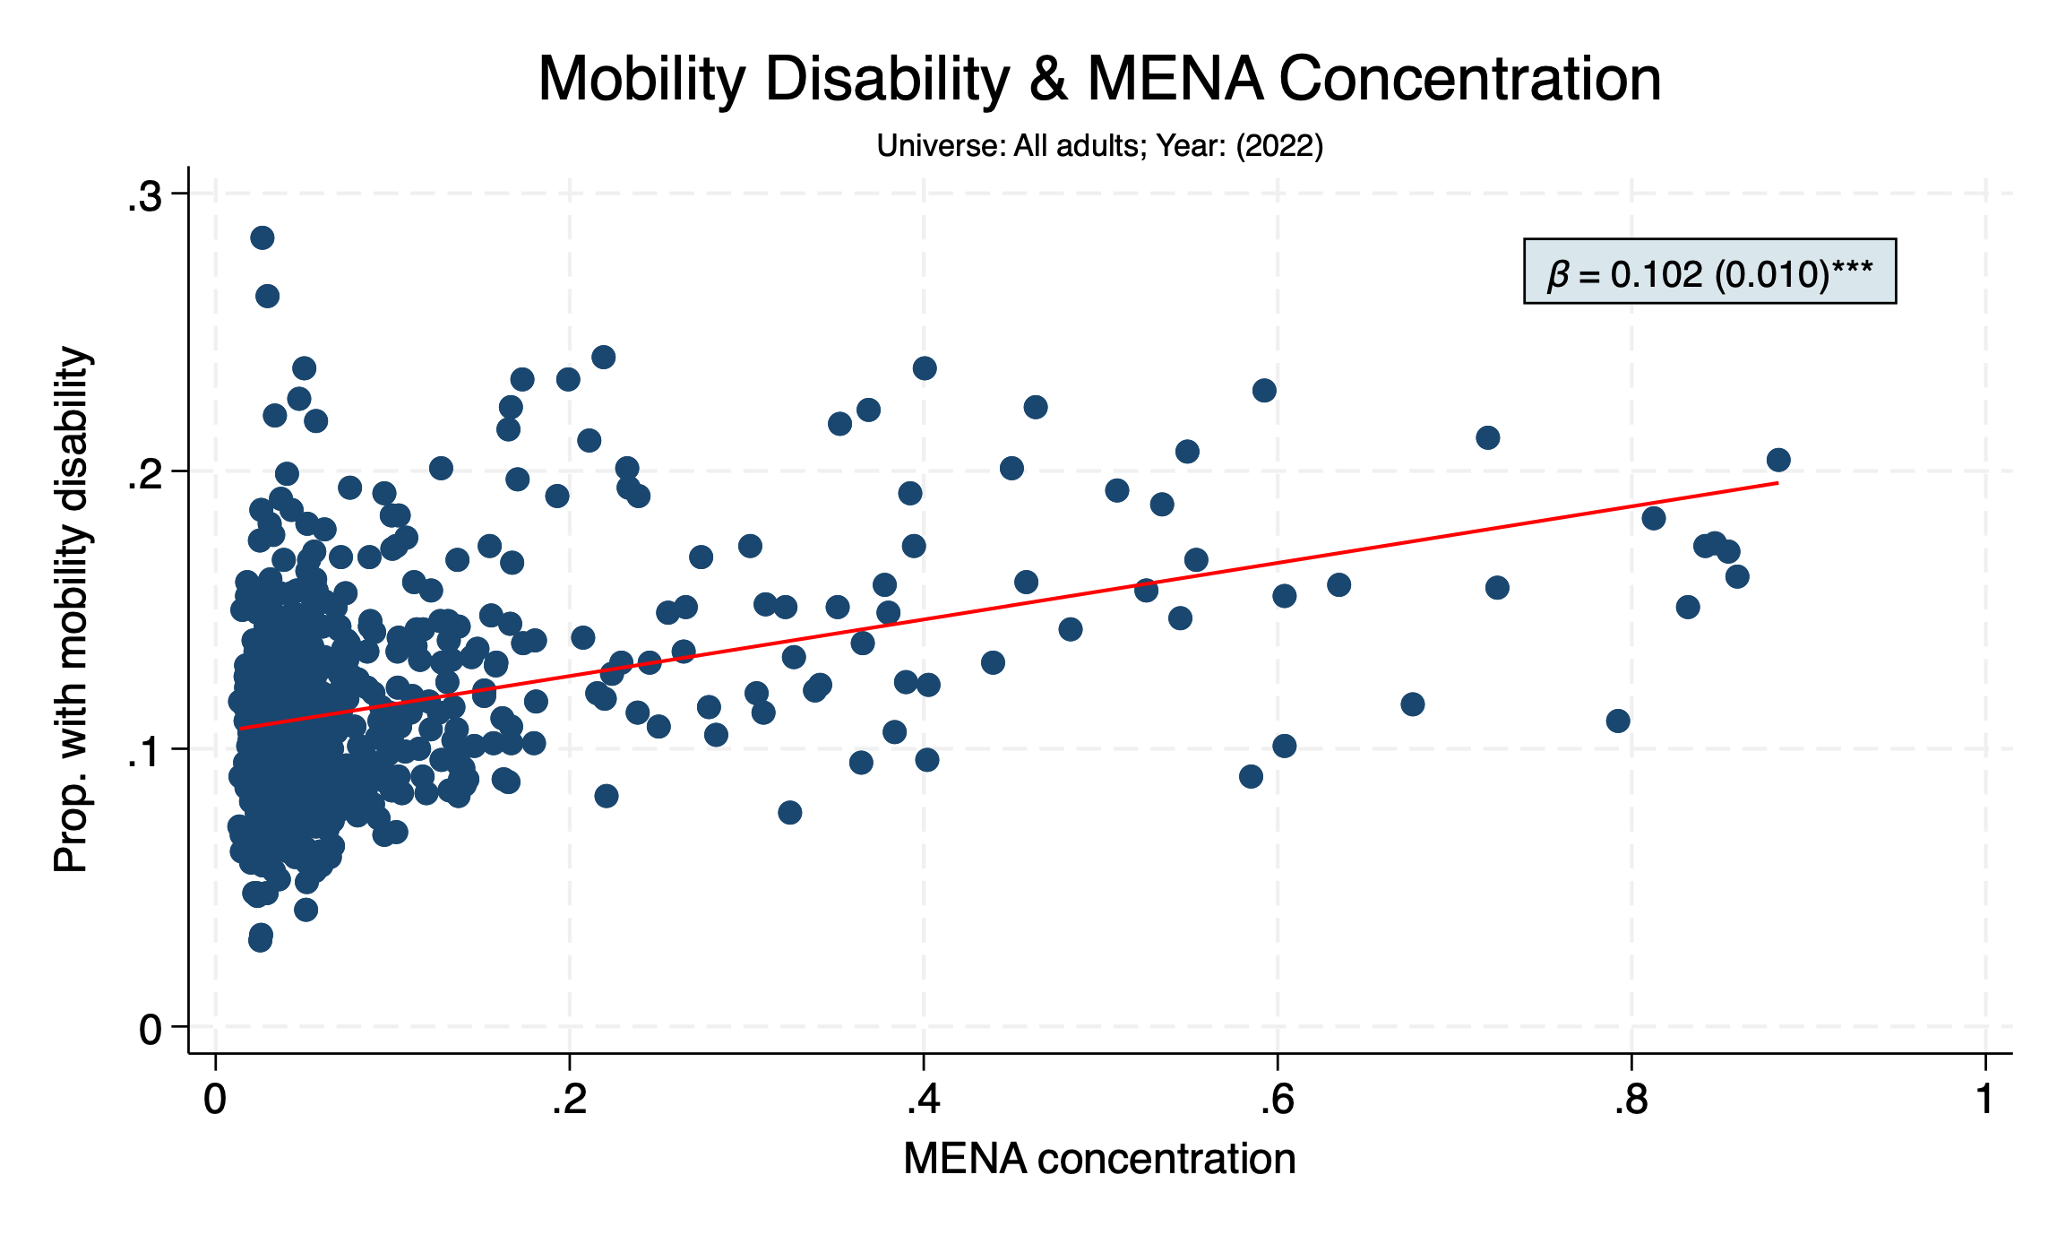

Slide 54
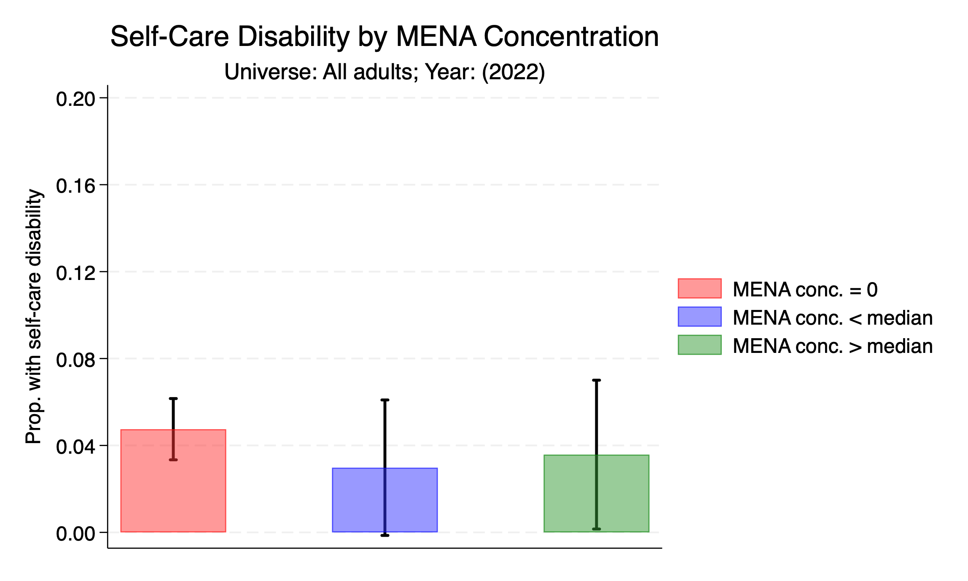

Slide 55
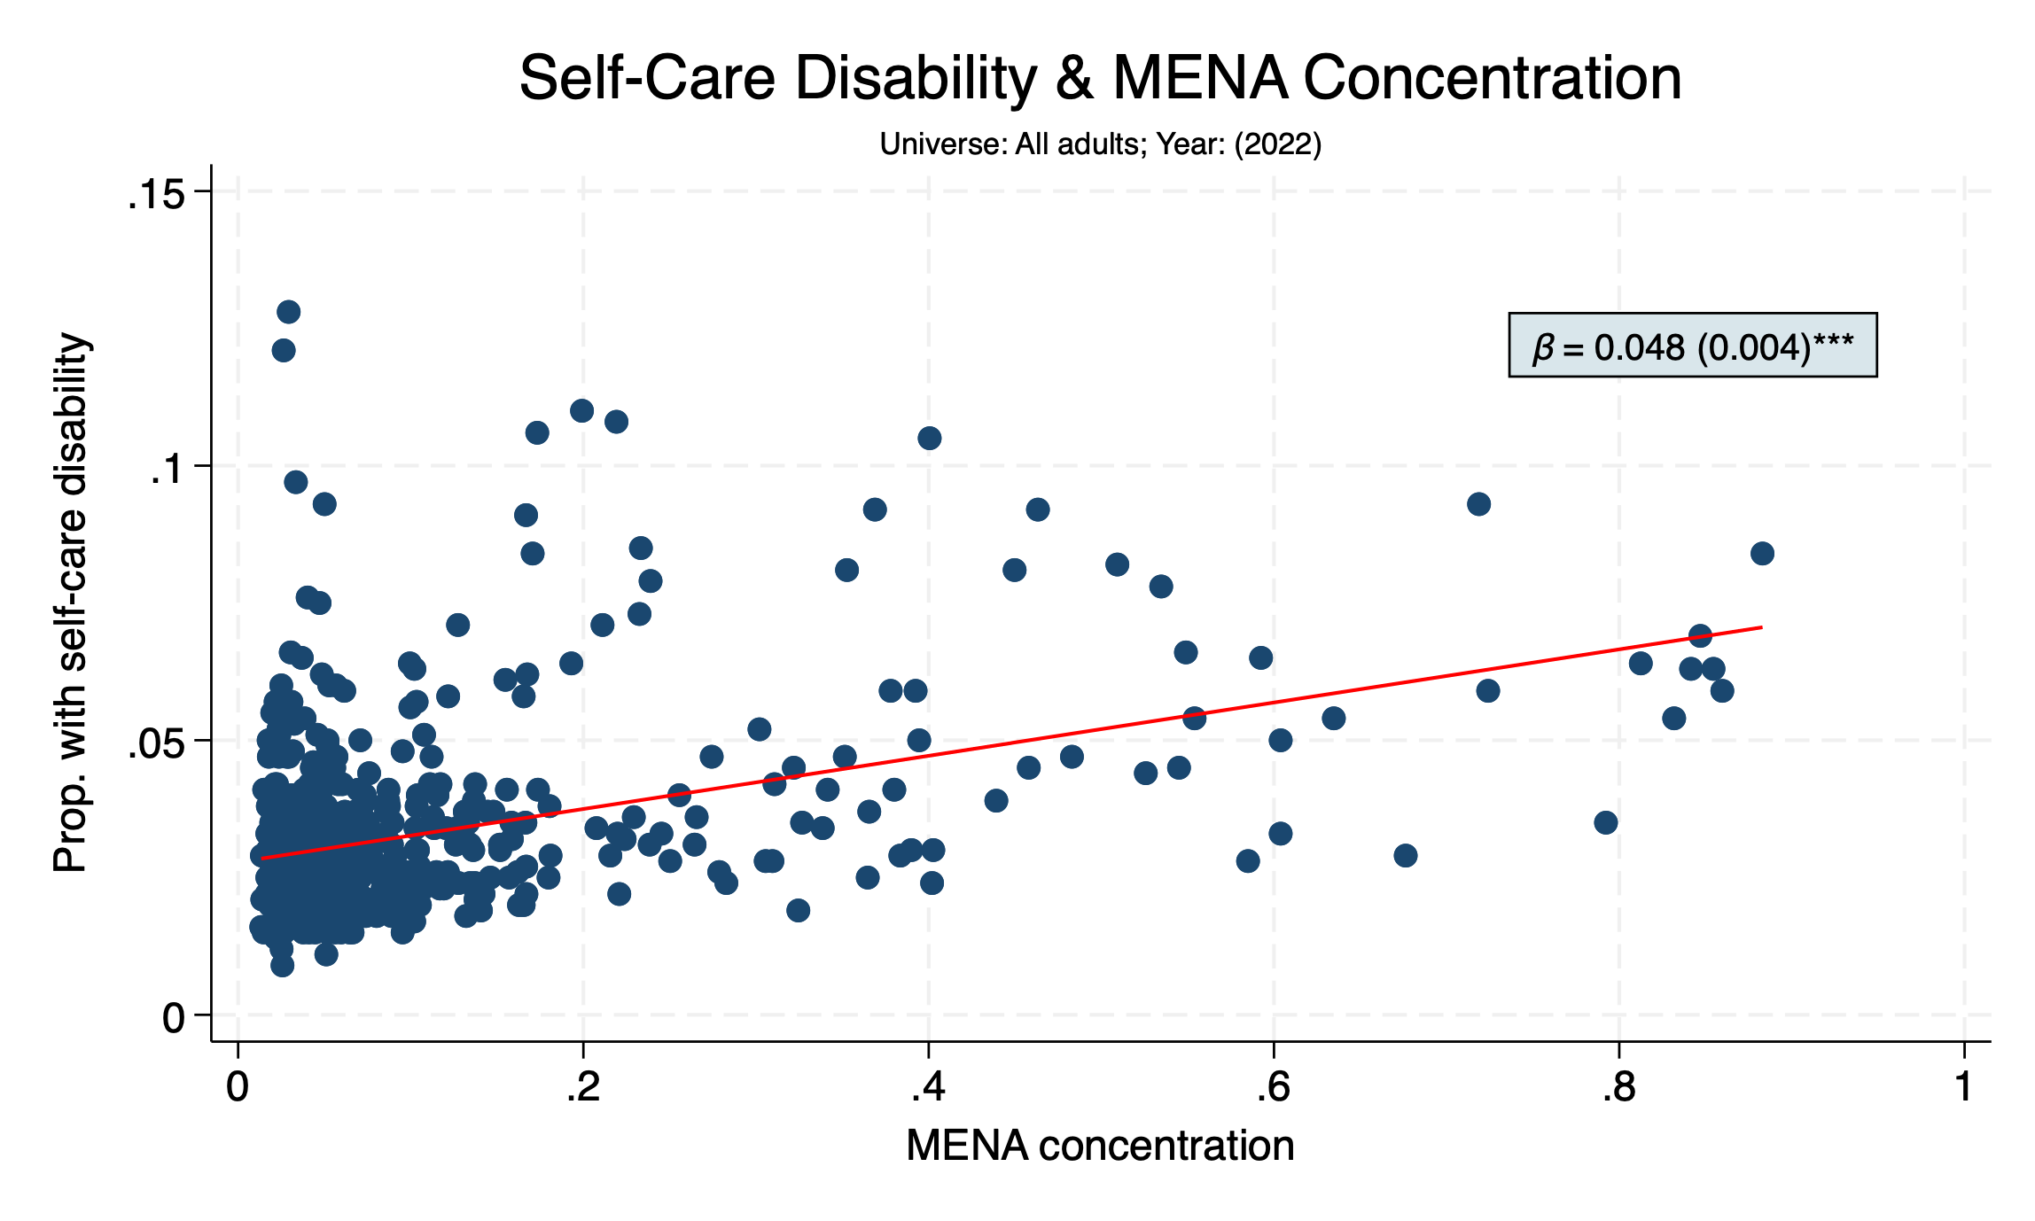

Slide 56
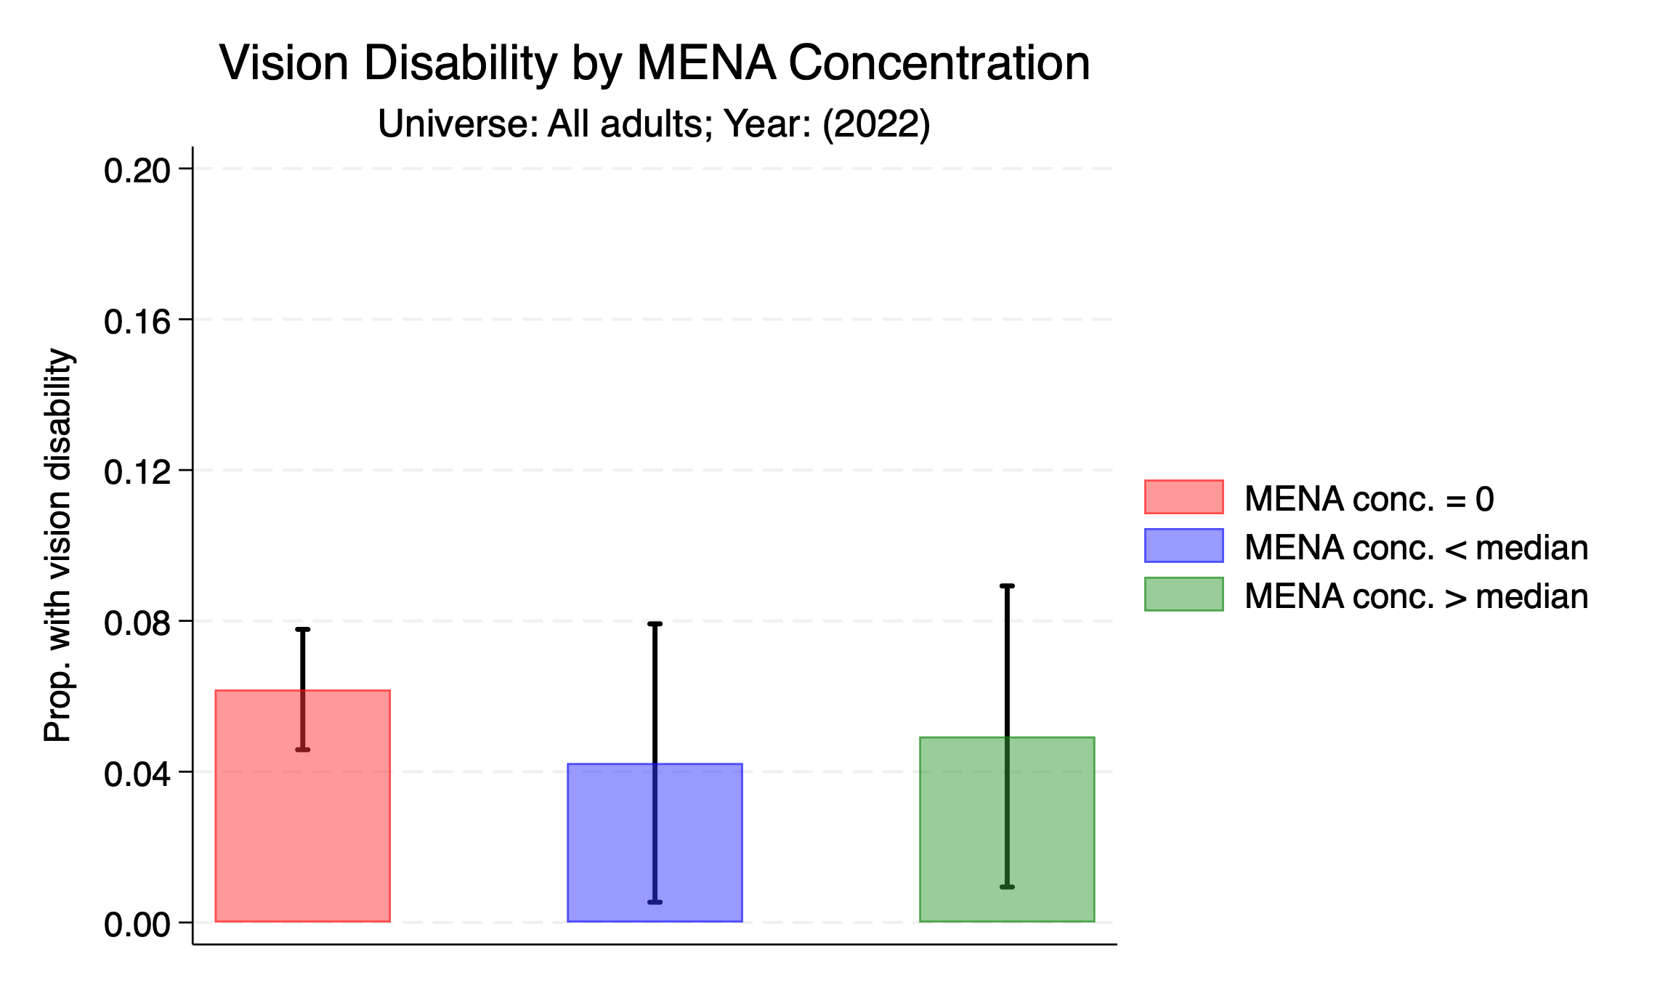

Slide 57
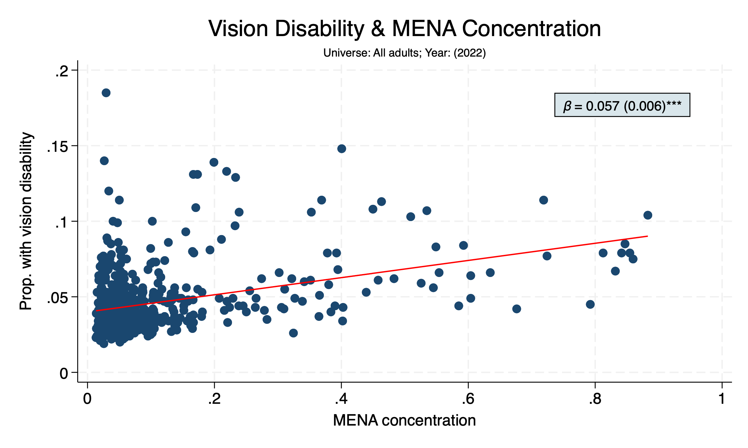

Slide 58
PREVALENCE OF RISK FACTORS

Slide 59
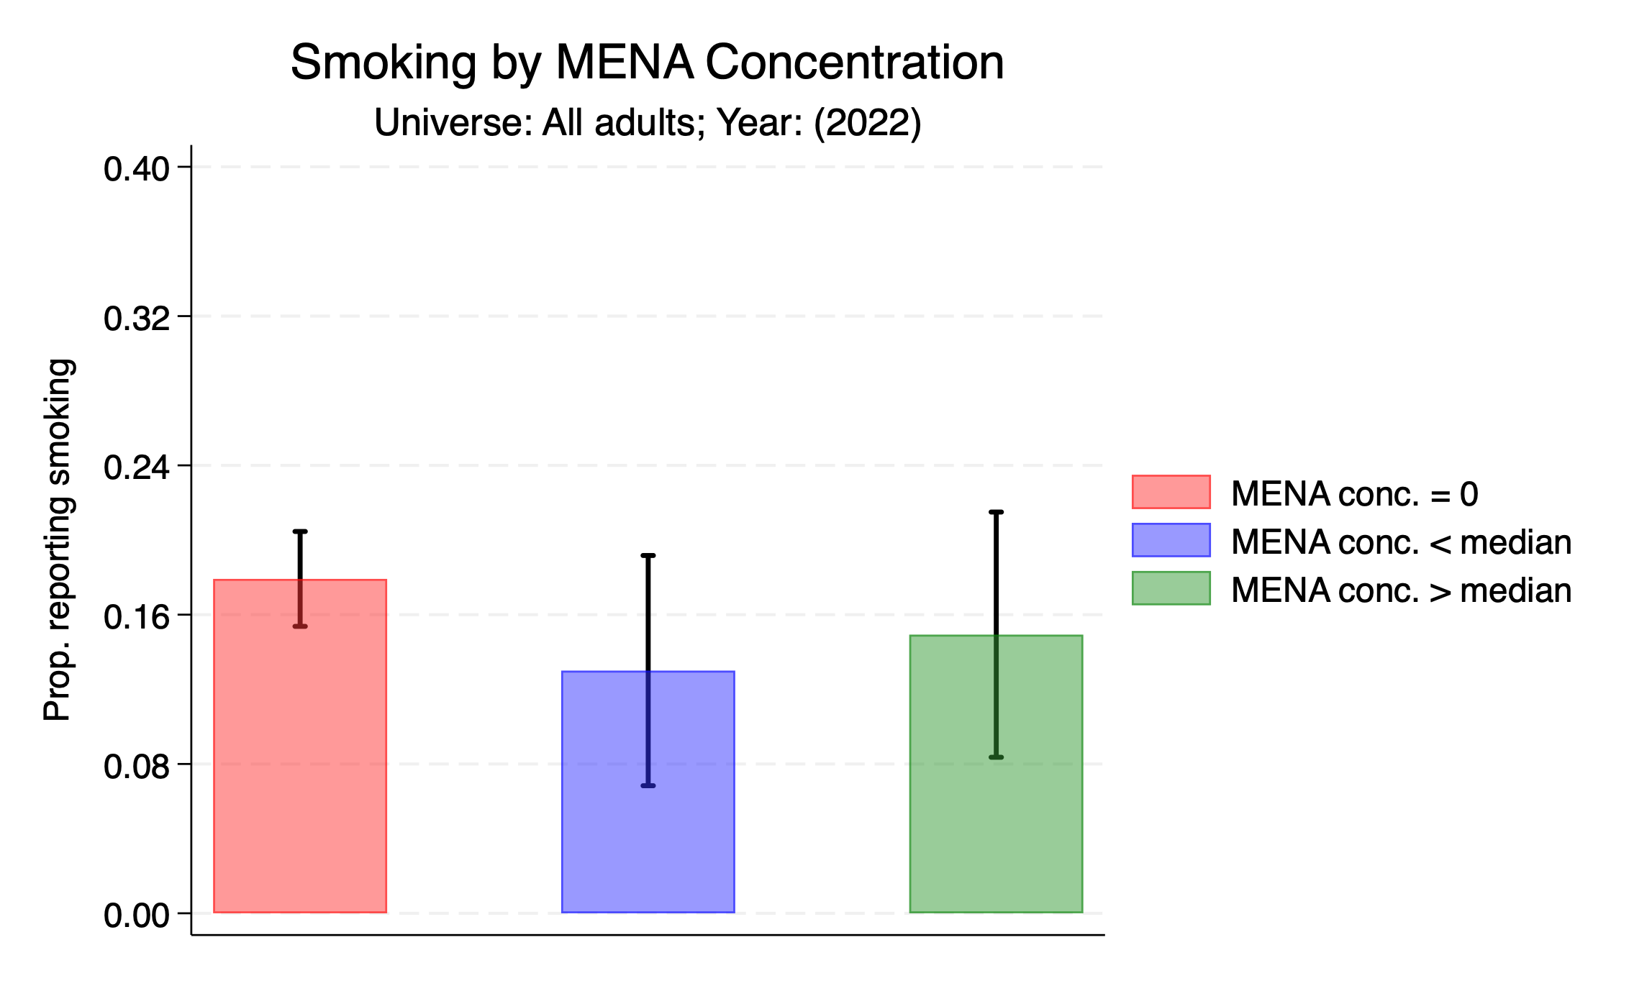

Slide 60
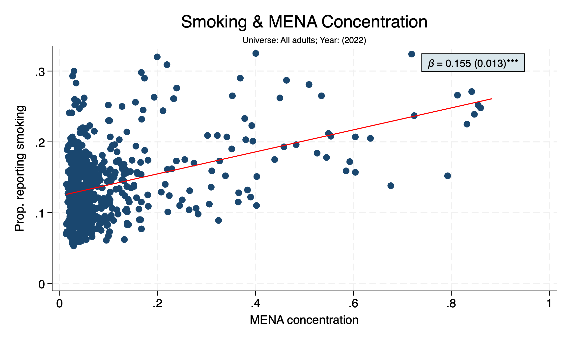

Slide 61
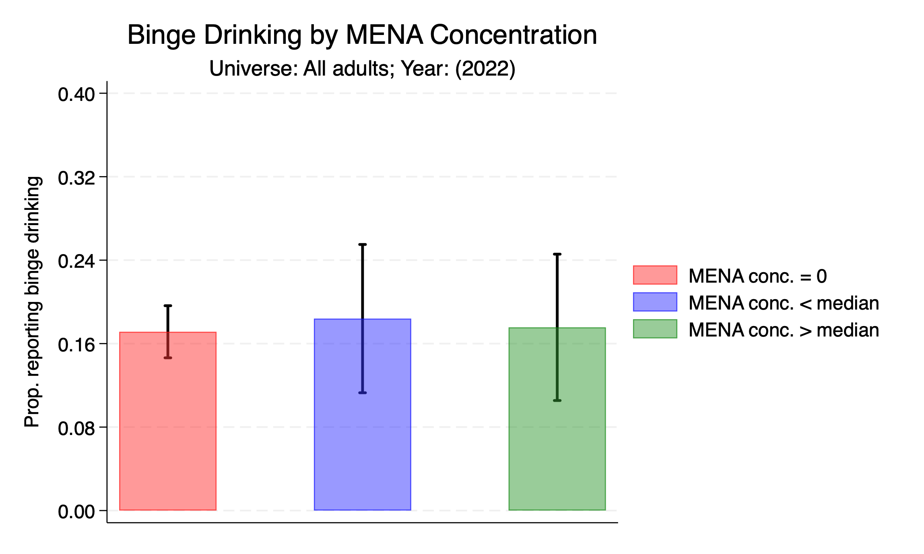

Slide 62


Slide 63


Slide 64


Slide 65


Slide 66


Slide 67


Slide 68


Slide 69


Slide 70


Slide 71
SELF-ASSESSMENTS OF HEALTH

Slide 72


Slide 73


Slide 74


Slide 75


Slide 76


Slide 77


